Slide 1
The Pelvic Floor
Why is it so important?

Slide 2
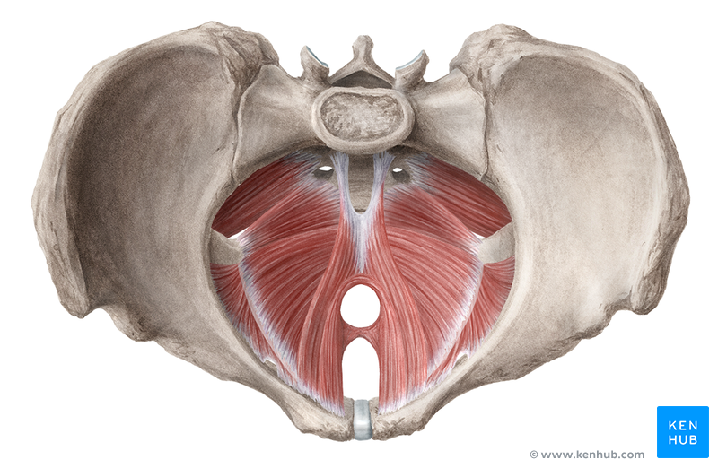
Contents
Pelvic floor anatomy
Pelvic floor disorders:
  Pelvic organ prolapse
    Types/ anatomy
    Assessment
    Treatment (how to teach
    Pelvic floor exercises)
  Urinary disorders
    Anatomy
    treatment
  Pelvic pain
    Causes
    Treatment techniques

Slide 3
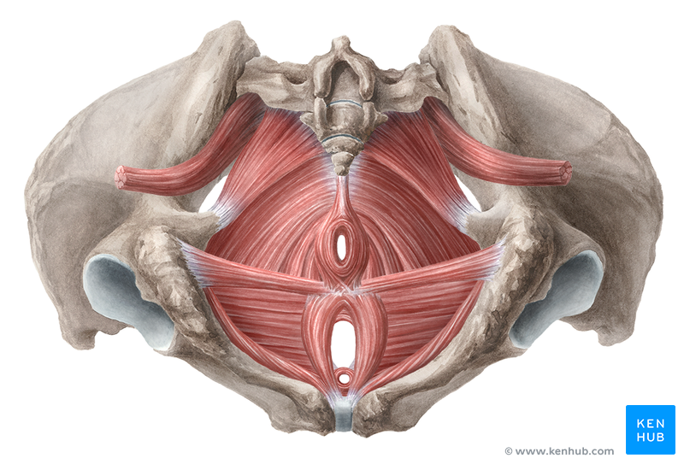
Pelvic Floor Anatomy
What is the pelvic floor?
“A complex web of muscle, fascia and fibrous tissue that helps support the pelvic organs”
Note: It is not just muscle!!!! Fascia and fibrous tissue are important too.

Slide 4
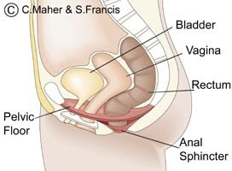
Muscular Components of the Pelvic Floor
Can be split into 2 layers:
1. Deep pelvic floor muscular layer (internal)
  Levator Ani
  Coccygeus
2. Superficial pelvic floor muscular layer (external)
  Urogenital triangle
  External anal sphincter

Slide 5
Muscular Component of the Pelvic Floor
Levator Ani
Deep Pelvic Floor Muscles (Internal)
Coccygeus
Pelvic floor muscles
Superficial Pelvic Floor Muscles (External)
Urogenital triangle
External Anal Sphincter

Slide 6
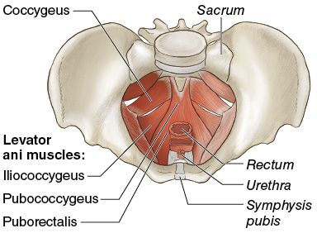
Deep Pelvic Floor Muscles: Levator Ani
Levator Ani (lifts Anus)
Function: Lifts to support the pelvic organs, removing strain on the endopelvic fascia.
3 separate muscles:
    Iliococcygeus
    pubococcygeus
    puborectalis

Slide 7
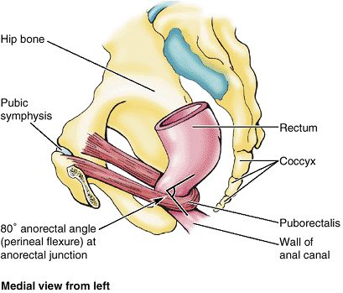
Deep Pelvic Floor Muscles: Levator Ani
Puborectalis
  PR creates a U-shaped sling around the anorectal junction. PR pulls the anorectal junction forward acting as a ‘kink’.
  When it relaxes it lengthens allowing for widening of the anorectal angle for bowels to open.
  Therefore it is important in maintaining faecal control (by contracting) and allowing defecation (by relaxing).
  Can cause chronic constipation if overactive.

Slide 8
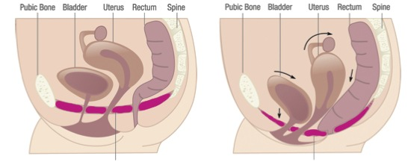
Deep Pelvic Floor Muscles: Levator Ani
Levator ani (all together) = Lift function
Clinical Note: If someone has an overactive Levator Ani you won’t feel much ‘lift’ on your internal examination as they’re already fully contracted.

Slide 9
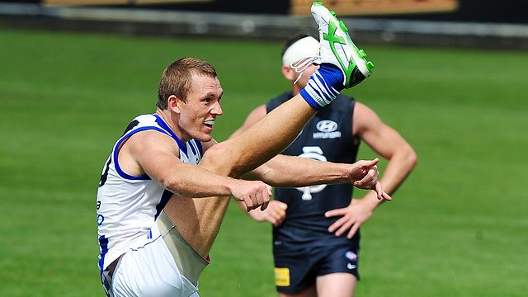
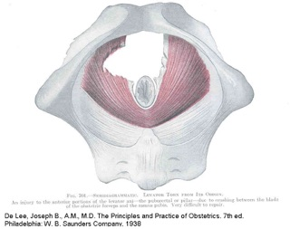
Food for thought
Skeletal muscle is supposed to rupture once it is stretched beyond about 150% of it’s resting length
During labour the Levator ani can reach an additional 259% of length.
For some women this will cause a complete avulsion of the Levator ani off the pubic rami
Dietz and Simpson (2008) found that women with avulsion are:
  2x as likely to suffer from POP
  2x as likely to develop an anterior wall prolapse
  4x as likely to develop a uterine prolapse

Slide 10
Deep Pelvic Floor Muscles: Coccygeus
Levator Ani
Deep Pelvic Floor Muscles (Internal)
Coccygeus
Pelvic floor muscles
Superficial Pelvic Floor Muscles (External)
Urogenital triangle
External Anal Sphincter

Slide 11
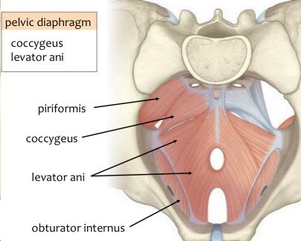
Deep Pelvic Floor Muscles: Coccygeus
Would control the tail if we had one.
Doesn’t elevate the anus.
Is thin and under developed due to evolution
Coccygeus

Slide 12
Superficial Pelvic Floor Muscles
Levator Ani
Deep Pelvic Floor Muscles (Internal)
Coccygeus
Pelvic floor muscles
Superficial Pelvic Floor Muscles (External)
Urogenital triangle
External Anal Sphincter

Slide 13
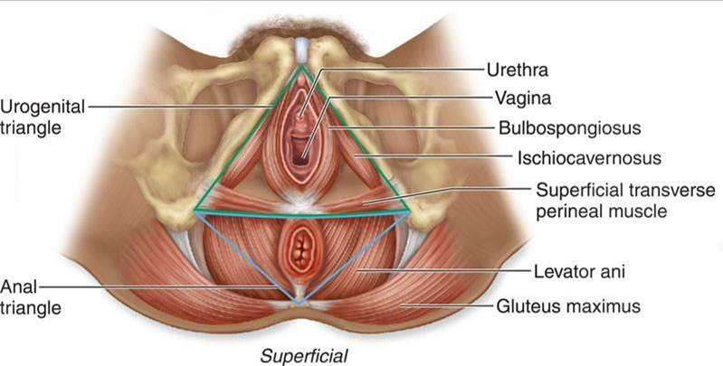
Superficial Pelvic Floor Muscles: Urogenital triangle
Anterior half: Urogenital triangle
Ischiocavernosus
Bulbocavernosus
Transvere Pereneii
Function: Provide added closure to vagina

Slide 14
Superficial Pelvic Floor Muscles
Levator Ani
Deep Pelvic Floor Muscles (Internal)
Coccygeus
Pelvic floor muscles
Superficial Pelvic Floor Muscles (External)
Urogenital triangle
External Anal Sphincter

Slide 15
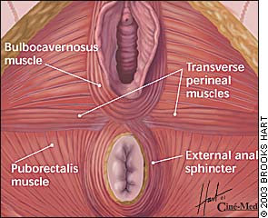
Superficial Pelvic Floor Muscles: External Anal Sphincter
Posterior Half:
External Anal Sphincter
Encircles the anus
Skeletal muscle
Voluntary control
Function: Provide added closure to anus
Provides 30% of resting anal closure pressure
Internal Anal Sphincter (IAS) provides 70% of resting anal pressure (not under voluntary control)

Slide 16
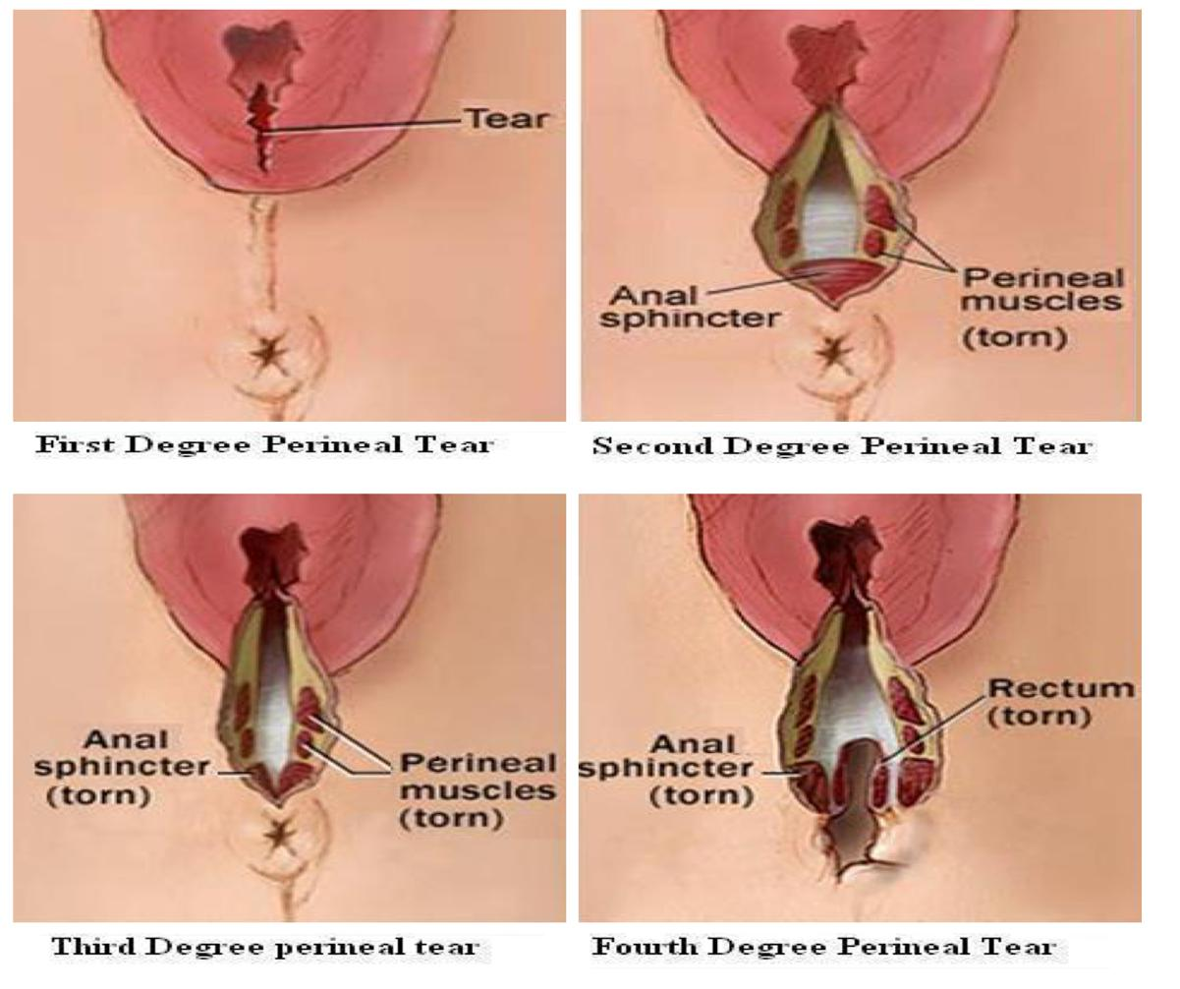
Clinical Note!!
Tears during vaginal deliveries
1st degree tear: Vaginal skin only
2nd degree tear: Vaginal skin + perineal muscles(superficial)
3rd degree tear: Vaginal skin, Perineal muscles (superficial) + Anal sphincters (EAS +/- IAS)
  3a: < 50% of EAS torn
  3b: >50 % EAS torn (IAS intact)
  3c: both EAS and IAS torn
4th degree tear
  EAS, IAS and mucosa torn

Slide 17
Clinical note!!
3c and 4th degree tears are the primary risk factor for faecal incontinence.
Very poor outcomes once IAS is torn.
Pelvic floor muscle training will only increase strength of EAS (skeletal muscles), not IAS (sympathetic)

Slide 18
Summary
Levator Ani
Deep Pelvic Floor Muscles (Internal)
Coccygeus
Pelvic floor muscles
Superficial Pelvic Floor Muscles (External)
Urogenital triangle
External Anal Sphincter

Slide 19
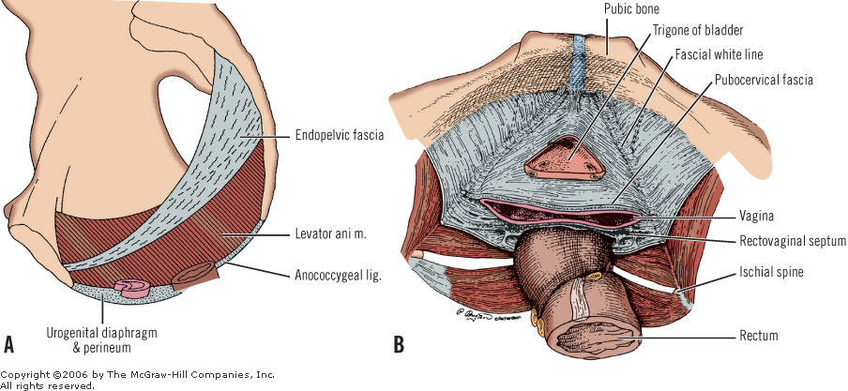
Don’t forget the fascia!
Endopelvic Fascia
Function: Connects pelvic organs to the pelvic side walls
Provides added support to pelvic organs
Suspends the organs
Note: Tearing/ stretching of the fascia = loss of organ support

Slide 20
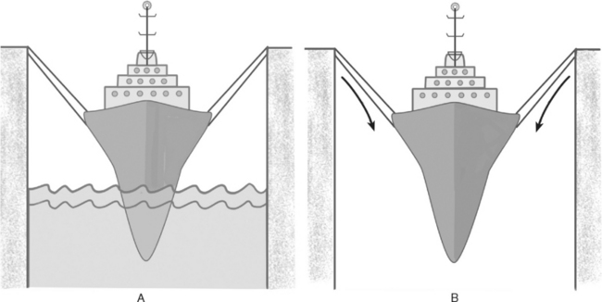
Boat in the dock analogy
Boat = pelvic organs
Ropes = fascia/ ligaments suspending the organs within he pelvis
Water = Pelvic floor muscles (levator ani) supporting the pelvic organs from the bottom up
Note: If the pelvic floor is weak there is increased strain on the fascia
If the fascia is torn/ stretched during child birth there is increased pressure on pelvic floor
Both may result in prolapse

Slide 21
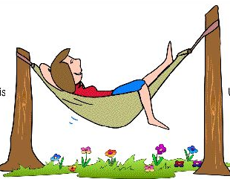
Hammock analogy
Legs = Rectum
Body = Uterus
Head = Bladder
Ropes = Fascia
Fascia
Hammock = Levator Ani
Lifts pelvic organs taking strain off fascia

Slide 22
Pelvic Floor Disorders
Pelvic Organ Prolapse (POP)
Urinary Disorders
Bowel disorders
Pain disorders

Slide 23
Prolapse

Slide 24
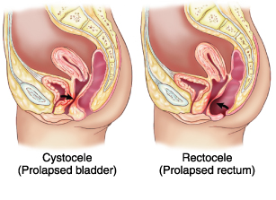
Prolapse: Rectocele
Posterior vaginal wall prolapse
Dropping of rectum forward and downward against posterior wall of vagina
Symptoms
Vaginal mass/ fullness
Sensation of stool becoming ‘stuck’ as it moves through rectum
Incomplete evacuation
Digital splinting to assist evacuation

Slide 25
Prolapse: Cystocele
Anterior vaginal wall prolapse
Dropping of bladder base down and backward against anterior vaginal wall
Symptoms:
Vaginal mass/ fullness
Recurrent UTI secondary to incomplete emptying
Lower abdo dragging/ discomfort
Obstructive/ irritable voiding symptoms
  Hesitancy, straining to void, slow flow, incomplete emptying, double voiding, post void dribble, leaning forward to void

Slide 26
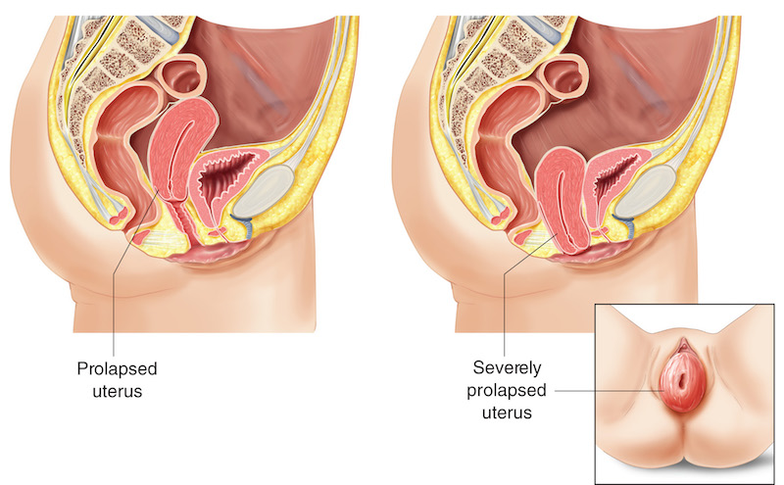
Prolapse: Uterine prolapse
Dropping of uterus down the vagina
Symptoms:
Vaginal mass/ fullness
  Perineal pressure (like a displaced tampon)
  LBP
  Painful intercourse
  Mass at introitus
  Obstructive urinary symptoms

Slide 27
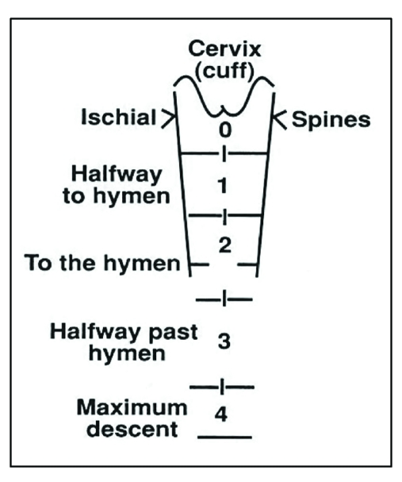
Prolapse Grading
Braden-Walker
  Most commonly used by physiotherapists
  Uses 2 main reference points
    Half way point down the vagina
    Hymen
Grades:
0 = Normal anatomical position
1 = Descent less than half way to hymen (mild prolapse)
2 = Descent more than half way to hymen, up to, or slightly beyond the hymen (mod prolapse)
3 = Half of organ is past the hymen (severe prolapse)
4 = Complete eversion

Slide 28
Management of Prolapses
Strengthen pelvic floor muscles
Increase upward support
Reduce heavy lifting
Teach ‘The Knack”
Appropriate exercise
Pessaries
Decrease downward strain
3 main goals
Manage respiratory conditions
Manage constipation
Provide tips for symptom management
Toilet position
Healthy BMI
Manual correction

Slide 29
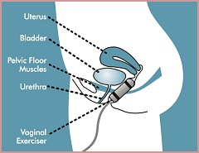
Management of prolapse: Pelvic floor muscle training
Step 1: Ensure correct technique
Verbal cues (see next slide)
Internal examination: Check correct technique, measure strength of contraction, check position of prolapse, feel for trigger points, Levator Ani avulsion
If patient unable to contract pelvic floor – Electrical stimulation
Step 2: Increase pelvic floor strength
Tailored HEP
Vaginal weights

Slide 30
Handy Hint
There’s no polite way of explaining a pelvic floor contraction.
Use imaginative verbal cues to help your patient visualise what they are meant to do.
Imagine you are sitting on a silk scarf and you’re trying to suck it up your vagina
Squeeze around your back passage as if you’re trying to hold in gas or diarrhoea
Imagine you’re urinating and you’re trying to stop yourself mid flow
Imagine you’re sucking up a milkshake through a straw… Only with your vagina instead of mouth

Slide 31
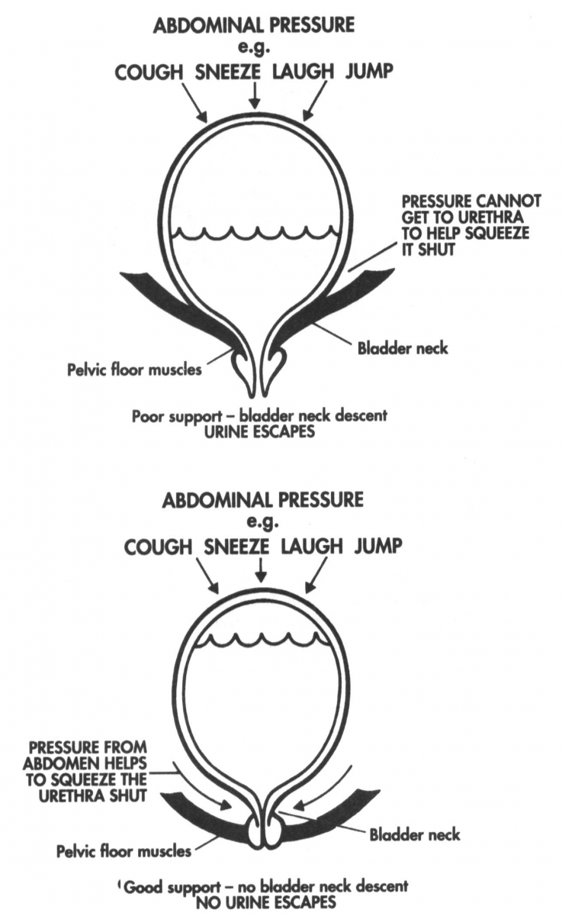
Management of Prolapse: The Knack
Often used as management for SUI
“Tensioning of the pelvic floor muscles just prior to and during increases in IAP to prevent downward descent of the pelvic floor and subsequent strain on the pelvic fascia”
Cough
Contract
Lift

Slide 32
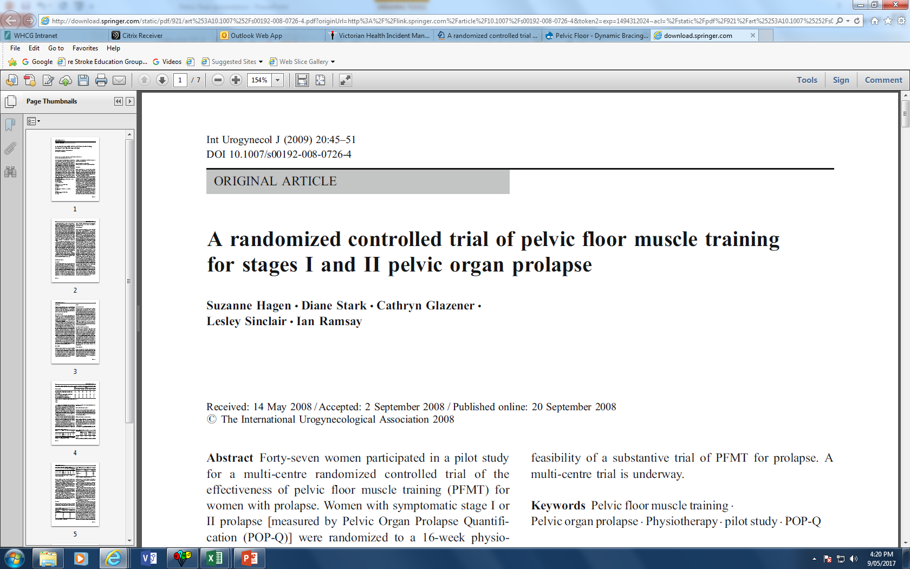
Does Pelvic Floor Muscle Training actually help?
Hagen at al 2009
47 women with grd 1 or 2 POP randomised to:
  Treatment group: 5 x session with specialist PF physio for PFMT
  Control group: send a standardised lifestyle advice leaflet
Results:
  Intervention group had significantly greater improvements in prolapse symptoms and prolapse grade

Slide 33

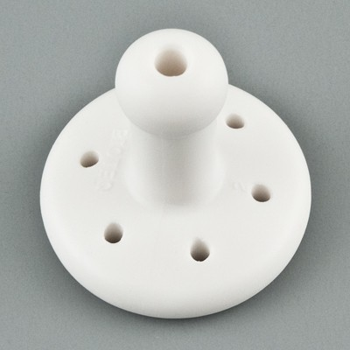
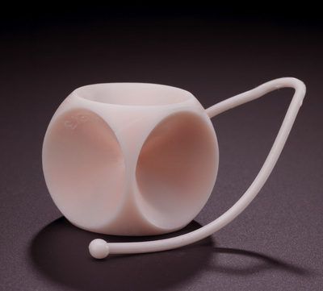
Management of prolapse: Pessaries
A removable device placed into the vagina. It is designed to support areas of pelvic organ prolapse.
Usually fitted by gynaecologists, some physiotherapist’s are trained to fit.
Ring Pessary
Easy to insert and remove
Can remain in situ for 3-6/12
Very effective for ant and uterine prolapse
Requires reasonable PF tone
Gellhorn Pessary
Can only be removed by health professional
Unable to have intercourse
Stronger than ring (can anchor to uterus or sit on levator hiatus)
Cube Pessary
Easy to insert/ remove
Must remove regularly (every 1-3 days)
Suctions to walls of vagina (strong)
Can often work if pt has weak PF or avulsion

Slide 34
Pelvic Floor Disorders
Urinary Disorders

Slide 35
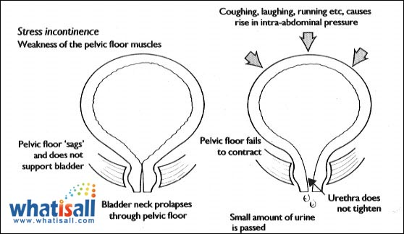
Urinary Disorders: Stress Urinary Incontinence
Definition: Involuntary loss of urine during increased abdominal pressure, eg. Sneeze or cough
For urine to remain in the bladder Intravesicle pressure (pressure in the bladder) must remain lower than urethral pressure.
If pelvic floor muscles are weak, the bladder neck is poorly supported
The weak pelvic floor is unable to maintain urethral closure pressure in response to increased abdominal pressure (eg. Cough)
Urine leaks out.
https://www.youtube.com/watch?v=3KRhhxVfGH0

Slide 36
Management of SUI
1. The knack: Squeeze and lift action of Levator ani provides counteraction to downward IAP – closing compression of urethra
  Teaching the knack is predominantly about improving coordination
2. Pelvic floor strengthening: Permanent changes to muscle morphology, increased resting tone, increased cross sectional are of the muscle.
  Level 1 evidence (Cochrane review Dumoulin and Hay-Smith (2010)): Benefits are greatest for women with SUI alone over mixed incontinence
3. Other options
  Weight loss
  Oestrogen replacement
  Artificial supports of urethra

Slide 37
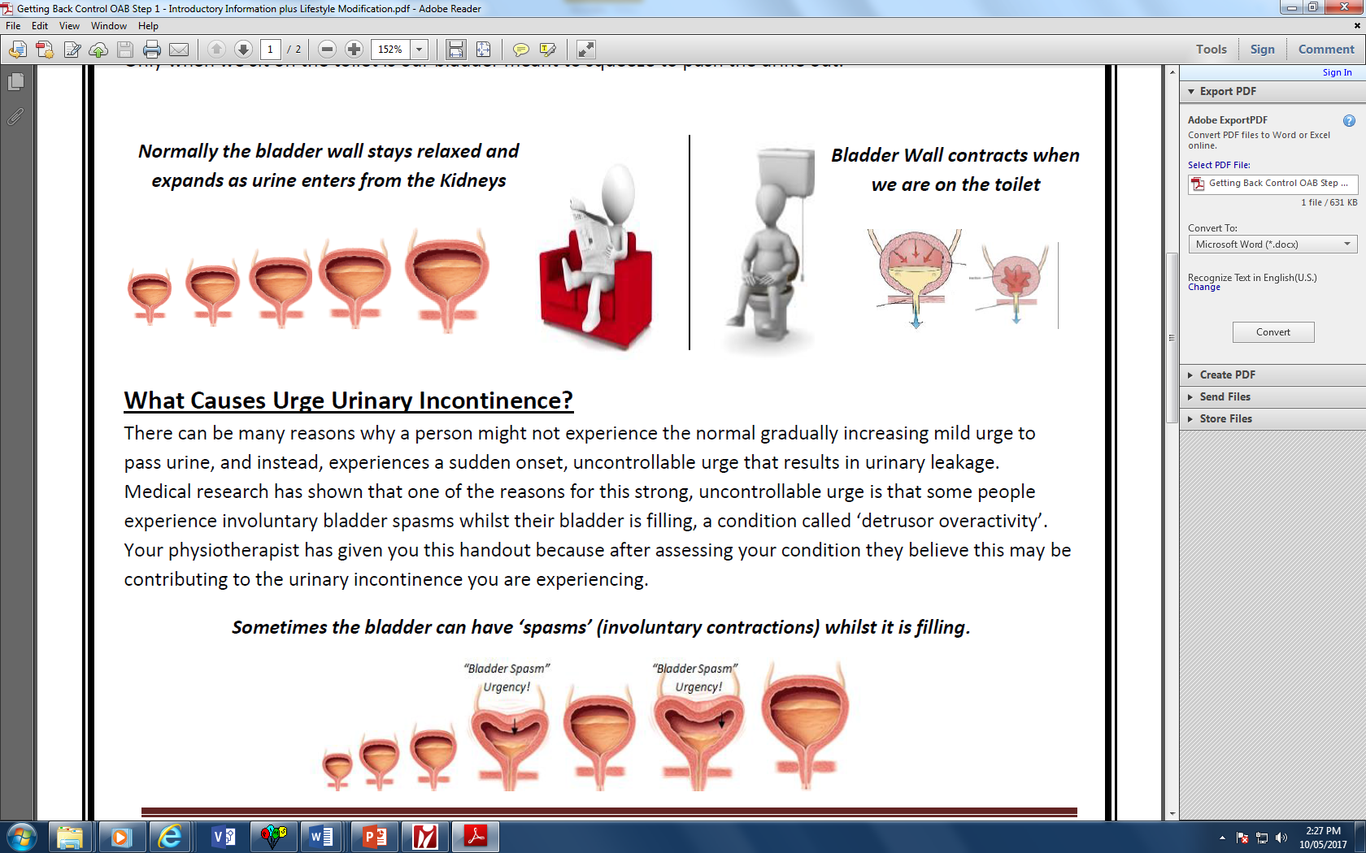
Urinary Disorders: Urgency
Urgency: “A sudden, compelling, difficult to defer desire to pass urine”
  Eg. If you were at the cash register at the supermarket and got the urge to pass urine, could you wait until you have paid, or would you have to leave your shopping, to go to the toilet
Urgency incontinence: involuntary loss of urine associated with urine
  Eg. If you leak on the way
Overactive bladder: symptomatic urinary urgency, usually with frequency and nocturia, with or without urge incontinence, that occurs in the absence of infection or other pathology

Slide 38
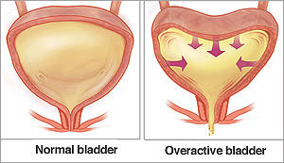
Overactive detrusor
During the storage phase the bladder normally stays relaxed as it expands to accommodate the increasing volume of urine in the bladder
In an overactive bladder, the detrusor muscle intermittently contracts during filling
This causes the person to experience urgent desires to pass urine at small volumes

Slide 39
Management of urgency/ OAB
Patient Education:
  Understanding OAB
Lifestyle advice:
  fluid management
  Bladder irritants
  Bowel management
Retraining Programs
  Behaviour retraining
  Trigger retraining
  Bladder retraining

Slide 40
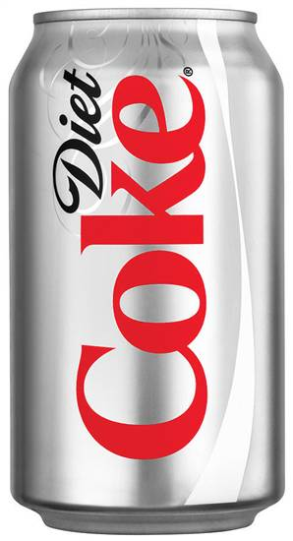
Bladder irritants
Artificial sweeteners
Caffeine
Carbonated drinks
smoking

Slide 41
Retraining Programs
Behaviour retraining

Slide 42
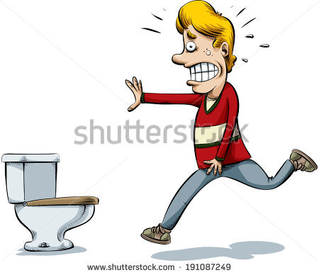
Behaviour Retraining
Theory behind behaviour retraining: The instinctive response to a sudden sensation of urinary urgency (detrusor overactivity) is to begin rushing to the toilet.
Problems with this instinctive reaction
  Periods of detrusor overactivity are times of high intravesicle pressure on bladder
  Rushing to the toilet at this time increases pressure on the bladder which increases chance of incontinence
  Repetitive pairing of urgency and voiding worsens the cycle (think Pavlovs dogs)

Slide 43

Behaviour retraining
We know that sudden episodes of urgency/ detrusor overactivity are likely to be temporary.
Therefore if a person can wait, sudden intense urgency sensation will likely pass and reduce to a more comfortable urge
We want to ‘ride the wave’ of urgency
BUT… Most people will be too scared to wait
So… We need to give them effective strategies to manage the urge if we’re going to make them wait.

Slide 44
4 known urge suppression reflexes
Activation of posterior tibial nerve
  Toe curling and calf contraction
Inhibition of detrusor via voluntary guarding reflex
  Voluntary pelvic floor contraction
Facilitation of frontal lobe
  Distraction techniques
Pressure on dorsal clitoral nerve of perineum
  Application of pressure to the perineum

Slide 45
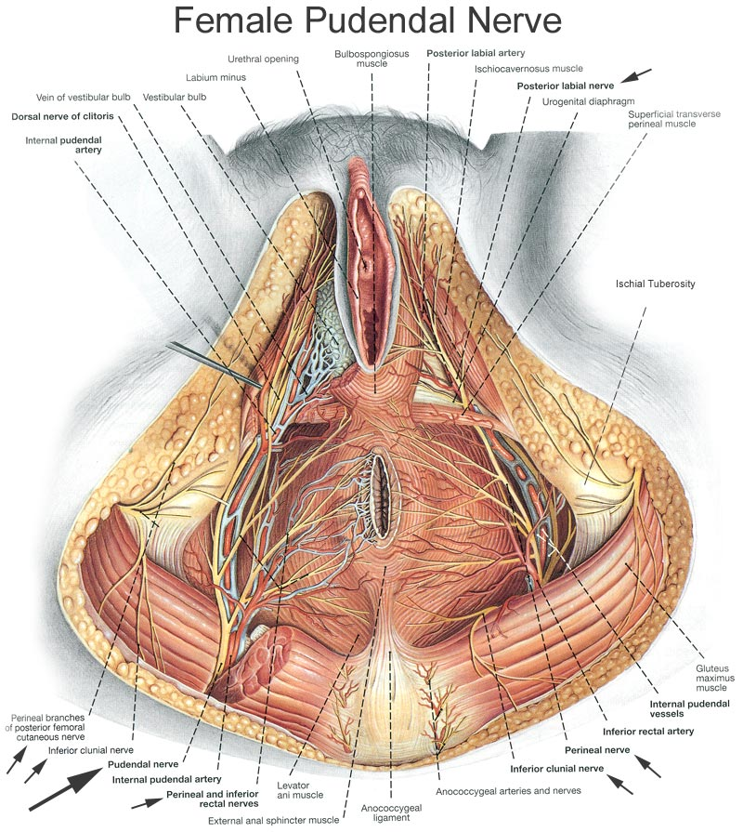
Dorsal Clitoral Nerve
Anatomy:
  Sensory branch of the Pudenal nerve
Background:
  Thought to be the reflex that is designed to inhibit urination during sexual intercourse
  Stimulation of the dorsal clitoral branch of pudenal nerve leads to reflex inhibition of detrusor activity
Implication:
  Applying perineal pressure during urgency can stimulate the sensory fibres of the dorsal clitoral branch of the pudneal nerve – inhibits detrusor activity
Technique:
  Apply pressure with hand, sit on corner of table, sit cross legged on foot etc.

Slide 46
Posterior Tibial Nerve Inhibitory Reflex
Anatomy:
  Posterior Tibial nerve has mix of m otor and sensory fibres
  Motor fibres cause ankle and toe movements (plantaflexion, toe curling, calf contraction)
  Sensory fibres project from these muscles and enter the spinal cord at S2.
  It is thought that some sensory fibres from the Bladder also enter the SC at S2.
Implications:
  Activation of these sensory fibres via calf contraction and toe curling may inhibit the passage of messages to and from the bladder (pain gate theory)
Technique: Calf pumps, toe curling

Slide 47
Voluntary Pelvic Floor Contraction
Normal Voiding
Detrusor Contracts
Pelvic Floor relaxes
Normal Storage
Detrusor relaxes
Pelvic floor contracts
This is the normal guarding reflex between the pelvic floor and detrusor.
Increased pelvic floor activity is thought to inhibit Detrusor contractility.

Slide 48
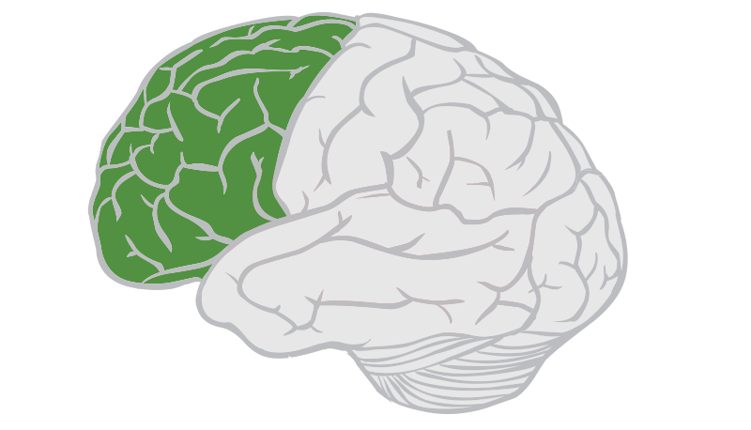
Facilitation of Frontal Lobe
Anatomy:
  Frontal lobe is an area of complex thought as well as bladder inhibition.
  Emotional responses fire the Limbic area of the brain
  Stress/ anxiety about urgency will result on movement of cortical activity from frontal lobe to limbic area (emotion)
  Movement away form frontal lobe reduces inhibition of bladder
  Concentration/ distraction techniques allow frontal lobe to remain active
Technique:
  Counting backwards, crosswords, shopping list

Slide 49
Pelvic Floor Disorders
Pain disorders

Slide 50
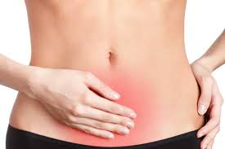
Causes of pelvic pain
There are many causes of pelvic pain, some of which are very difficult to diagnose and treat. Some of the more common types are listed below:
  Period pin (dysmenorrhoea)
  Endometriosis
  Bloating and bowel issues
  Painful sex (Dyspareunia)
  Interstitial cystitis
  Ruptured ovarian cyst
  Pudenal Neuraligia
http://www.pelvicpain.org.au

Slide 51
Pelvic floor muscle spasm
For people with stabbing pelvic pain and painful sex, often the cause is overactive pelvic floor muscles.
The only way to ascertain if someone has an overactive pelvic floor is via internal examination.
Useful treatments:
  Soft tissue/ trigger point release by physiotherapist
  Using heat (eg. Hot bath) when spasm occur to relax the muscles
  Avoid core exercises (eg pilates) as may aggrevate symptoms
  Treat other causes of pain so there is less need to hold muscles tightly.
  Pelvic floor relaxation techniques
    https://www.pelvicexercises.com.au/pelvic-floor-relaxation-exercises/
    https://www.youtube.com/watch?v=JZtb6ZDDQ2g
  If so severe that internal examination is difficult, Botox injection may be appropriate.

Slide 52
Clinical Note!
Clinical Note:
If someone has an overactive pelvic floor and is told to do pelvic floor exercises, it could make things worse!
Always get the patient’s pelvic floor assessed first.

Slide 53

Take Home Messages
The pelvic floor is a complex web of muscle and fascia and is important in maintaining continence and supporting the pelvic organs
The pelvic floor plays a major role in many conditions such as pelvic organ prolapse, stress urinary incontinence, urgency and urge incontinence, and pelvic pain. Hence it should always be assessed and included in the treatment plan.
Ensure internal examination’s are done for accurate diagnosis and tailored treatment programs.

Slide 54
Useful Resources
http://www.pelvicpain.org.au
http://www.womenshealthtrainingassociates.com/
https://www.continence.org.au/
https://www.pelvicexercises.com.au/

Slide 55
Acknowledgements
Taryn Hallam: Principal Lecturer Women’s Health Training Associates
http://www.pelvicpain.org.au

