Slide 1
Stoma Nursing Care
Kathryn Mayne RN Division 1. STN
Integrated Living Australia(formerly BDNH)
28/6/20017

Slide 2
A + P of Gastrointestinal Tract
1. Food is transported form the mouth to the stomach by the oesophagus
2. The liquid material is passed into the small intestine which consists of
(a) the duodenum, approximately 25cm long. Neutralizes acid and gastric contents. Receives the openings of the bile and pancreatic ducts.
(b) the jejunum and Ileum measure about 6 meters long. Major organ for nutrient absorption.
3. Waste material passes into the colon. Functions of the colon include; collection, concentration, transport and elimination of intestinal waste material. The colon consists of
(a) the caecum, which lies below the junction of the Ileum with the large intestine. It contains the Ileocaecal valve which prevents reflux into the Ileum. Contents are highly acidic liquid.
(b) the ascending colon- contents are acidic liquid
(c) the transverse colon- contents are acidic liquid
(d) the descending colon- contents become more formed
(e) the rectum- formed stool

Slide 3
The intestinal System
With thanks to ConvaTec

Slide 4
Stoma
An incised opening that is kept open for drainage or other purposes, such as an opening in the abdominal wall for Colostomy, Ileostomy, and Ileal Conduit.
“ Care of the patient with a stoma, for whatever reason it may have been created, is primarily concerned with developing in the patient an attitude of independence and freedom from restrictions on his/her physical, social, and recreational activities once he has been discharged from the hospital”(1)
A stoma may be Permanent or Temporary.
A permanent Ostomy is constructed when the rectum, colon or bladder have been removed.
A temporary stoma
(a) May be placed in the small or large intestine or the urinary tract
(b) considered to be temporary if it is to be reversed within 6 months of surgery
(c) temporary faecal diversions are performed to divert the faecal stream away from obstruction, new anastomosis, operative site or infection.

Slide 5
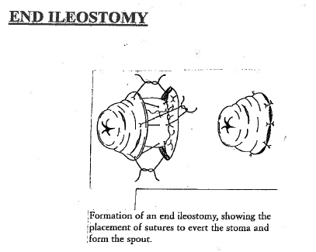
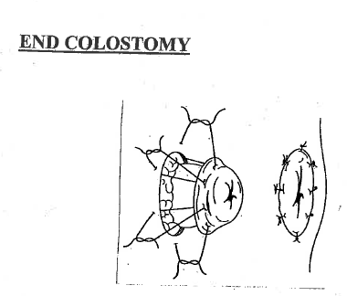
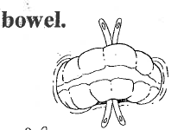
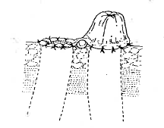
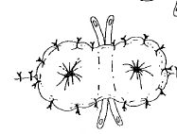
Types of Stoma
END Stoma. The bowel is cut and brought to the surface of the skin and everted into a bud. The distal portion of bowel is removed or oversewn.
LOOP Stoma. An entire loop of bowel is brought to the skin surface. The anterior wall of the bowel is opened resulting in two openings. The proximal end is the functioning side and the distal stoma is the nonfunctioning side. (The distal side may also be called a Mucous Fistula due to the normal mucous secretions it produces)

Slide 6
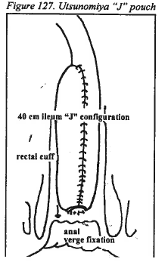
Types of Stoma
Double barrel stoma: The bowel is divided and both ends are brought to the skin surface as two separate stomas. It is created when total diversion of bowel is needed.
Ileoanal reservoirs – J. Pouch
Normally indicated for thin patients under the age of 55 with ulcerative colitis or familial adenomatous polyposis. “A J shaped two-limbed reservoir is constructed from the terminal ileum”(2).It is fashioned into an internal pouch, and attached to the rectal segment that has been stripped of its mucosal lining. This allows semi-liquid stool to be passed through the rectum via normal pathways. May be a two step procedure that requires a temporary Loop Ileostomy.

Slide 7
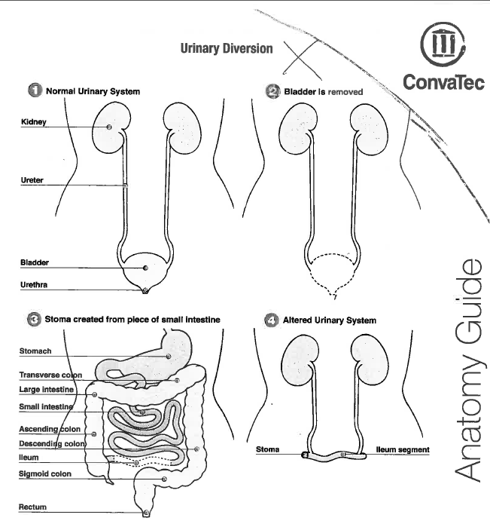
Types of stomas
Ileal Conduit.
“use of a segment of the Ileum for the diversion of urinary flow from the ureters. The segment is resected from the intestine with nerves and blood supply intact. The proximal end of the segment is closed, forming a pouch, and the ends of the ureters are sutured to it. The distal end is brought to the outside of the abdominal wall and effaced to form a stoma. The remaining ends of the small intestine are anastomosed to reestablish bowel continuity” (3).

Slide 8
Indications for Ostomy
Ileostomy:
Crohn’s Disease, Ulcerative Colitis, Cancer, Familial Polyposis, Trauma wounds
Colostomy:
Cancer, Diverticulitis, Congenital conditions, Trauma wounds, Faecal incontinence, Volvulus of the bowel, Bowel obstruction
Ileal Conduit:
Cancer, trauma, Congenital conditions, Neurogenic nonfunctioning bladder in which other devices are unsatisfactory.

Slide 9
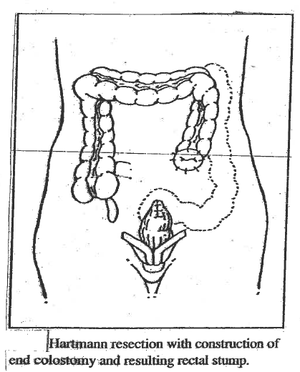
Bowel surgery that may result in a Faecal stoma
Types of surgery for Colon cancer
Right Hemicolectomy, Left Hemicolectomy, Transverse colectomy, Sigmoid colectomy
Hartmann’s procedure: resection of the diseased portion of the colon with the proximal end constructed into an end Colostomy, and the distal potion closed resulting in a rectal stump. The rectal stump continues to produce mucous.
Types of surgery for Rectal Cancer
Anterior resection, +/- temporary loop ileostomy
Abdominal-Perineal resection, end Colostomy

Slide 10
Psychological Issues to be considered
Fear of surgery, impact on body, outcomes, survival and stoma formation
Implications of a stoma in their life: eating, sleeping, working, loving, sports
Body image issues and self esteem
Embarrassment in regards to the stoma: elimination through the abdomen,
noise from flatus, smell, leakage
Cultural issues
Loss of control
Sexuality and relationships
Reproductive issues
How to tell others
Returning to work/ sport/ school/ social functions
How would you feel if you had a stoma?
What would be you concerns and fears?

Slide 11
Role of the Stomal Therapy Nurse
Work as part of a multidisciplinary team for the rehabilitation of people with stomas
Clinical responsibilities: Pre-op, post-op, Post discharge. Patient teaching, pre-op siting, selecting and fitting appliances, referrals, planning discharge and follow-up.
Promote independence for the client and/or significant other in stoma care.
Consultant responsibilities. The aim of developing specialist nursing skills is to ensure
better patient/client outcomes.
Provide emotional support
Provide education to the client +/- significant other: applying a bag, problem solving, when to seek help, diet, fluid balance, increased fluid intake, what the stoma and output should look like, clothes, costs and supply of stock, sexuality.
Provide education to nurses and other health care workers and ostomy groups.
Review and research current practices. Provide evidence based nursing.
Administration and managerial responsibilities; record keeping, statistics, stock management, additional stock ordering.

Slide 12
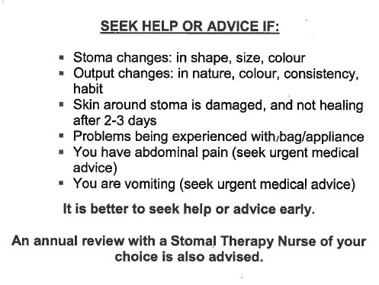
Teaching for independence
Use aids
Be guided by the client and significant other
Use written and visual material
Provide support until the client/significant other can manage
Provide reassurance and positive feedback
Encourage good set up and prompts for the procedure
Most stoma clients are provided with a discharge pack from their STN in hospital, encourage them to read when they feel ready
Teach to order supplies, mail, email, fax, on-line

Slide 13
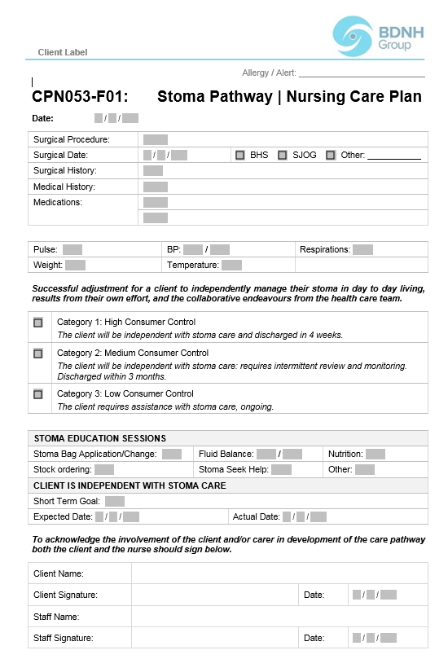
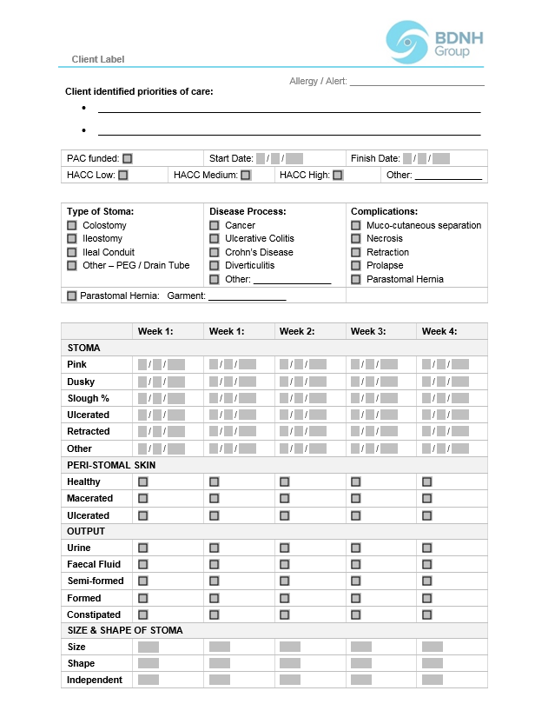
Stoma care plan used at Integrated Living Australia

Slide 14
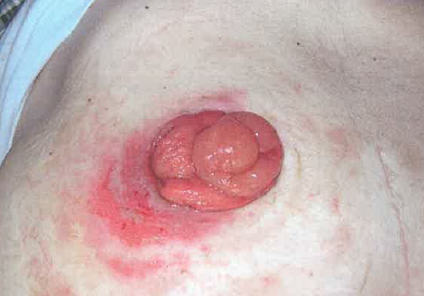
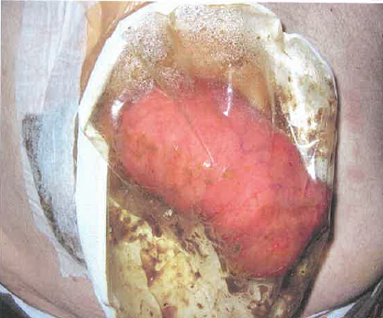
Care plan

Slide 15
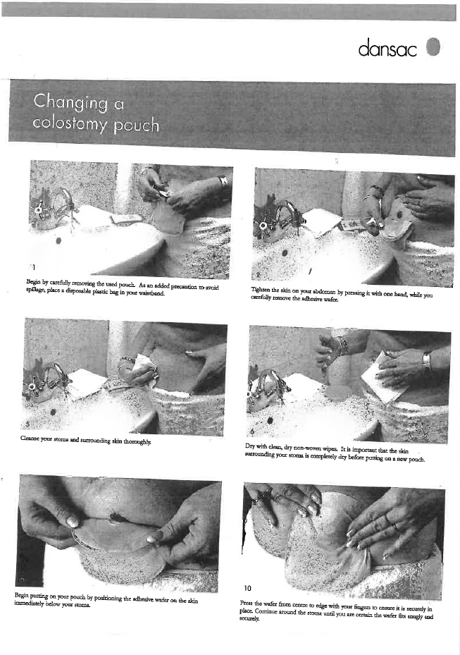
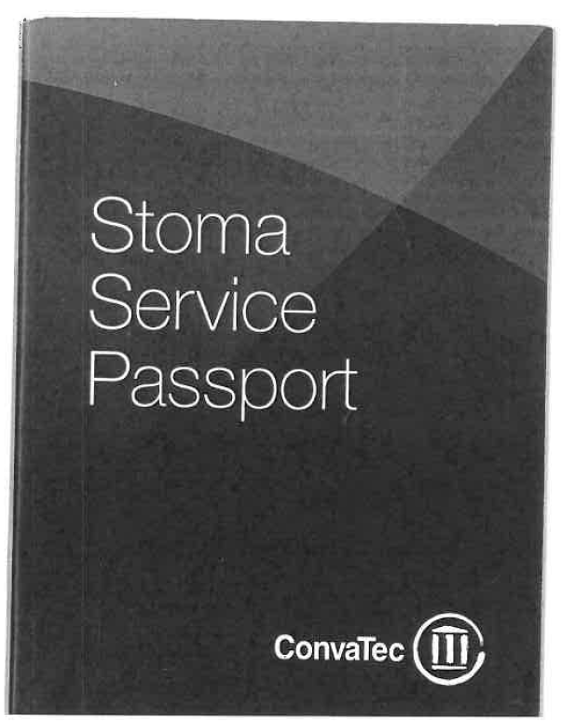
Example Patient information provided by Stoma supply companies With thanks to Dansac and Convatec

Slide 16
Refer to the STN
The bag is leaking/Skin reaction/change is size of stoma
Site problems: retracted, prolapsing, may need a change of appliance
Parastomal hernia, ? needs a support garment
Stenosis of the stoma, refer to doctor
Treatment of granulomas around the stoma
Maceration/ulceration of the peristomal skin
Type of bag is no longer available
Problems with the supply of bags
Needs script for additional supplies
Would benefit from additional support
Client/significant other is struggling to cope with self care
AASTN provides Clinical Guidelines for Stomal Therapy Nursing Practice.

Slide 17
References
SNELL. Anatomy. “Clinical Anatomy for Medical Students”
1986 (1) + (3)
BLACKLEY P. “ Practical Stoma wound and Continence Management”
1989 (2) p 209
CONVATEC. Anatomy guide. “The Intestinal System” “Urinary diversion”
MILLER-KEANE. “Encyclopedia and Dictionary of Medicine, Nursing and Allied Health” 1978
DANSAC. Booklet. “Colostomy Care at home”

