Slide 1
SCUFF TRAINING FOR COMMUNITY SUPPORT WORKERS
SCUFF – Self Care Understanding for Feet
Adapted through collaboration between Wimmera Health Care Group and Horsham Rural City Council as part of the Grampians Region HACC Foot Care Program.

Slide 2
Thanks to:
Thanks to the Ballarat Foot Care Project and specifically to Gemma Hammond (BCH) and Adrian Misseri (BDNH) for compiling this presentation.

Slide 3
objectives
On completion of this module participants will
Have an understanding of personal carer and podiatrist role in assisting clients with foot care
Identify good footwear choices and assist people in selecting better footwear choices
Have an awareness of current aids, methods and equipment used to support foot and nail care
Be able to support clients in applying good nail and foot care

Slide 4
Topics to be covered
Role of podiatrist
Role of Community Care Worker in foot hygiene
High Risk Factors
Good Foot Care
Tools of Trade
Corns & Callous
Footwear

Slide 5
A podiatrist is……
Health professional – diagnosis, treatment and prevention of disorder of feet and lower limbs
A range of skills are used for example:
Orthotic prescription and manufacture
Wound management
Minor nail surgery
Footwear advice
Treatment of skin and nail disorders of the feet

Slide 6
Importance of foot care
Poor foot care - mobility and independence
Impaired vision
Inability to reach feet
Falls prevention
Not necessarily pathological feet
role of personal carer

Slide 7
Personal Carer’s role
Personal carer’s role may encouraging and supporting people to:
Regular washing of person’s feet
Careful drying, especially between the toes
Regular checking of condition of skin and nails of feet and lower legs
Moisturising and massaging skin of feet and lower legs (not between toes)
Filing of nails
Maintaining level of callous (under podiatrist advice)
Assisting person with purchase of appropriate shoes

Slide 8
High risk factors
Anyone with any of the following conditions should be seen by a podiatrist:
Diabetes
Peripheral vascular disease
Nervous system disorders
Blood disorders ie haemophilia, blood thinning medications
Conditions or medications affecting the immune system
Lymphoedema

Slide 9
Good foot care
Cut nails straight across
File corners if necessary
Pumice hard skin & calluses
Apply moisturiser to heels
Dry well between toes
Attend to injuries
Wear suitable/ fitted shoes
Natural fibre socks & stockings - not too tight.
Notice abnormalities consult a Podiatrist or your doctor

Slide 10
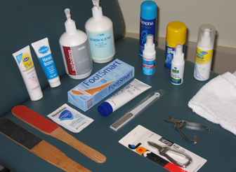
Tools of the trade
Clippers
File/ Pumice stone
Moisturiser
Towel
Warm soapy water
If necessary - antiseptic, mirror, hypoallergenic tape.
Mirror helpful if mobility restricted

Slide 11
NEVER ……
Expose your feet to extremes of temperature
Wear tight stockings or shoes
Use “medicated” corn plasters
Sit with crossed legs for too long
Smoke

Slide 12
Minimising cross infection
Handwashing
Foot preparation of the person’s feet
Use of disposable gloves
Breaks in the skin – to the person or carer should be dealt with in the appropriate manner

Slide 13
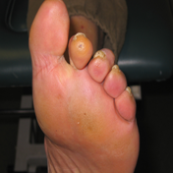
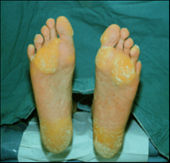
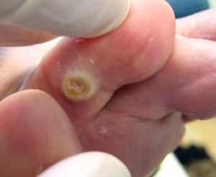
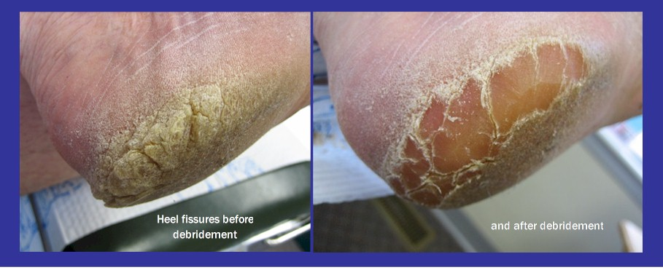
Identifying corns and callous

Slide 14
Corns and callous
Normal protective response to abnormal pressure/ friction
Pressure centred over small area or bony prominence
Indicator of underlying problem
Ill-fitting/ inappropriate footwear
Management carried out under podiatrist advice

Slide 15
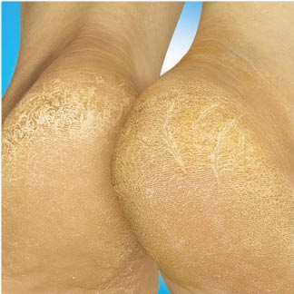
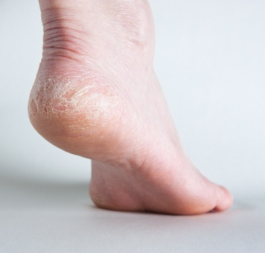
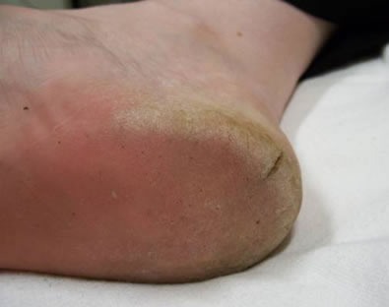
Avoiding and managing callous
Footwear with heel cradle
Pumice stone/foot file
Creaming feet
Cushioning insoles

Slide 16
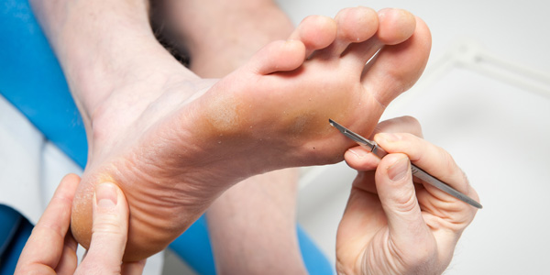
Management of corns
Requires podiatrist input
The podiatrist will often pad the area
Protection of active corns
Toefoam, silicon padding
Dressing if there is break in skin
Footwear fit to prevent
further damage

Slide 17
footwear
Ensure proper fit
Should be the same shape as the foot
Always have new shoes properly fitted
Go shopping for shoes at end of day
Suitable & supportive for your activities
Check insides of shoes regularly
Footwear shouldn’t cause problems in any way

Slide 18
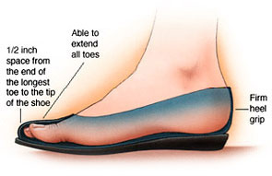
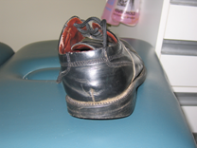
Footwear features
Natural fibre eg leather
Non-slip rubber sole
Lace or buckle for good fit
Adequate toe box depth & shape
Length: 1cm between longest toe and end of shoe
Firm heel cup
Worn shoes should be repaired or or discarded

Slide 19
Footwear pyramid
Wear Least
Wear Occasionally
Moderately
Wear Most

Slide 20
Footwear and lymphoedema
Expandable, well fitted footwear
All day socks
Wear compression hosiery/elevate feet to reduce problem of fit
Hygiene improved by washable hosiery
Careful cleansing followed by moisturising of skin around (not between) toes essential

Slide 21
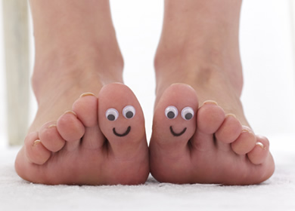
Summary of Session
Good foot care assists maintain good health & independence & can help reduce falls risk
Basic skin & nail maintenance assists in avoiding foot health issues such as corns, callous, non-healing sores (ulcers)

Slide 22
SUMMARY - What can be done?
Strategies include:
Careful washing & drying feet
Creaming feet (not between toes)
Reducing dry skin by filing
Reinforcing good nail care strategies
Using the right tools for the trade
Checking footwear condition & fit & encouraging footwear with good features
Screening of foot health enables identification of foot health issues which may require podiatrist input & care

Slide 23
Foot care training for community Support workers
Part 2 – Foot Care – Screening and Referral

Slide 24
Recap on previous session
Personal carer and podiatrist roles in assisting clients with foot care
Tools for identifying good footwear choices and ways to assist people in selecting better footwear choices
Awareness of current aids, methods and equipment used to support foot and nail care
Supporting clients in applying good nail and foot care

Slide 25
Objectives of this session
Consolidating knowledge of personal carer and podiatrist roles
Foot care issues of clients and what to do
Identifying red flags requiring immediate referral for medical care
Using the Foot Care Project Screening Tool
Demonstrate awareness of referral pathways for clients needing podiatric assessment
Demonstrate awareness of CSW role in implementing foot care support plan

Slide 26
Topics to be covered
Issues of foot health requiring podiatrist assessment
Red Flag signs & symptoms
Role of CSWs (see Role of CSW handout)
When & how to refer to podiatrist or GP
Using the Foot Care Project Screening Tool (Screening Tool Handout)
Case studies
Workshop activity
Request for personal care: Foot Care Support

Slide 27
Nail disorders
Thickened toenail – trauma to the nail
Excessively curved toenail
Ingrown toe nail
Fungally infected toenail (thickened, discolored)
Diagnosis and Management by a Podiatrist

Slide 28
Nail disorders

Slide 29
Nail disorders

Slide 30
Nail disorders

Slide 31
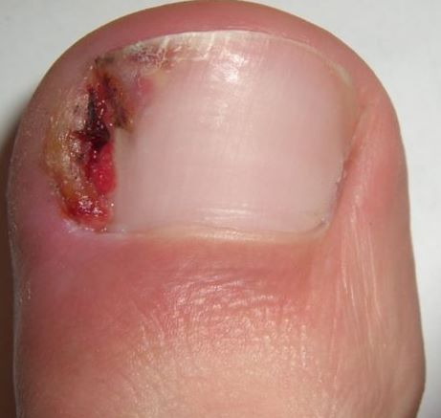
OTHER SIGNS & SYMPTOMS

Slide 32
Skin disorders
Callous –thickened, dead skin caused by excessive pressure, painful if untreated
Corns – a concentrated area of callous
Warts – caused by a viral infection
Tinea – a fungal infection of the skin.
Chilblains – often itchy and painful, they usually appear as reddish/purplish splotches of discolouration on extremities eg toes, heels, bony projections
Diagnosis and Management by a Podiatrist

Slide 33
Skin disorders

Slide 34
Skin disorders

Slide 35
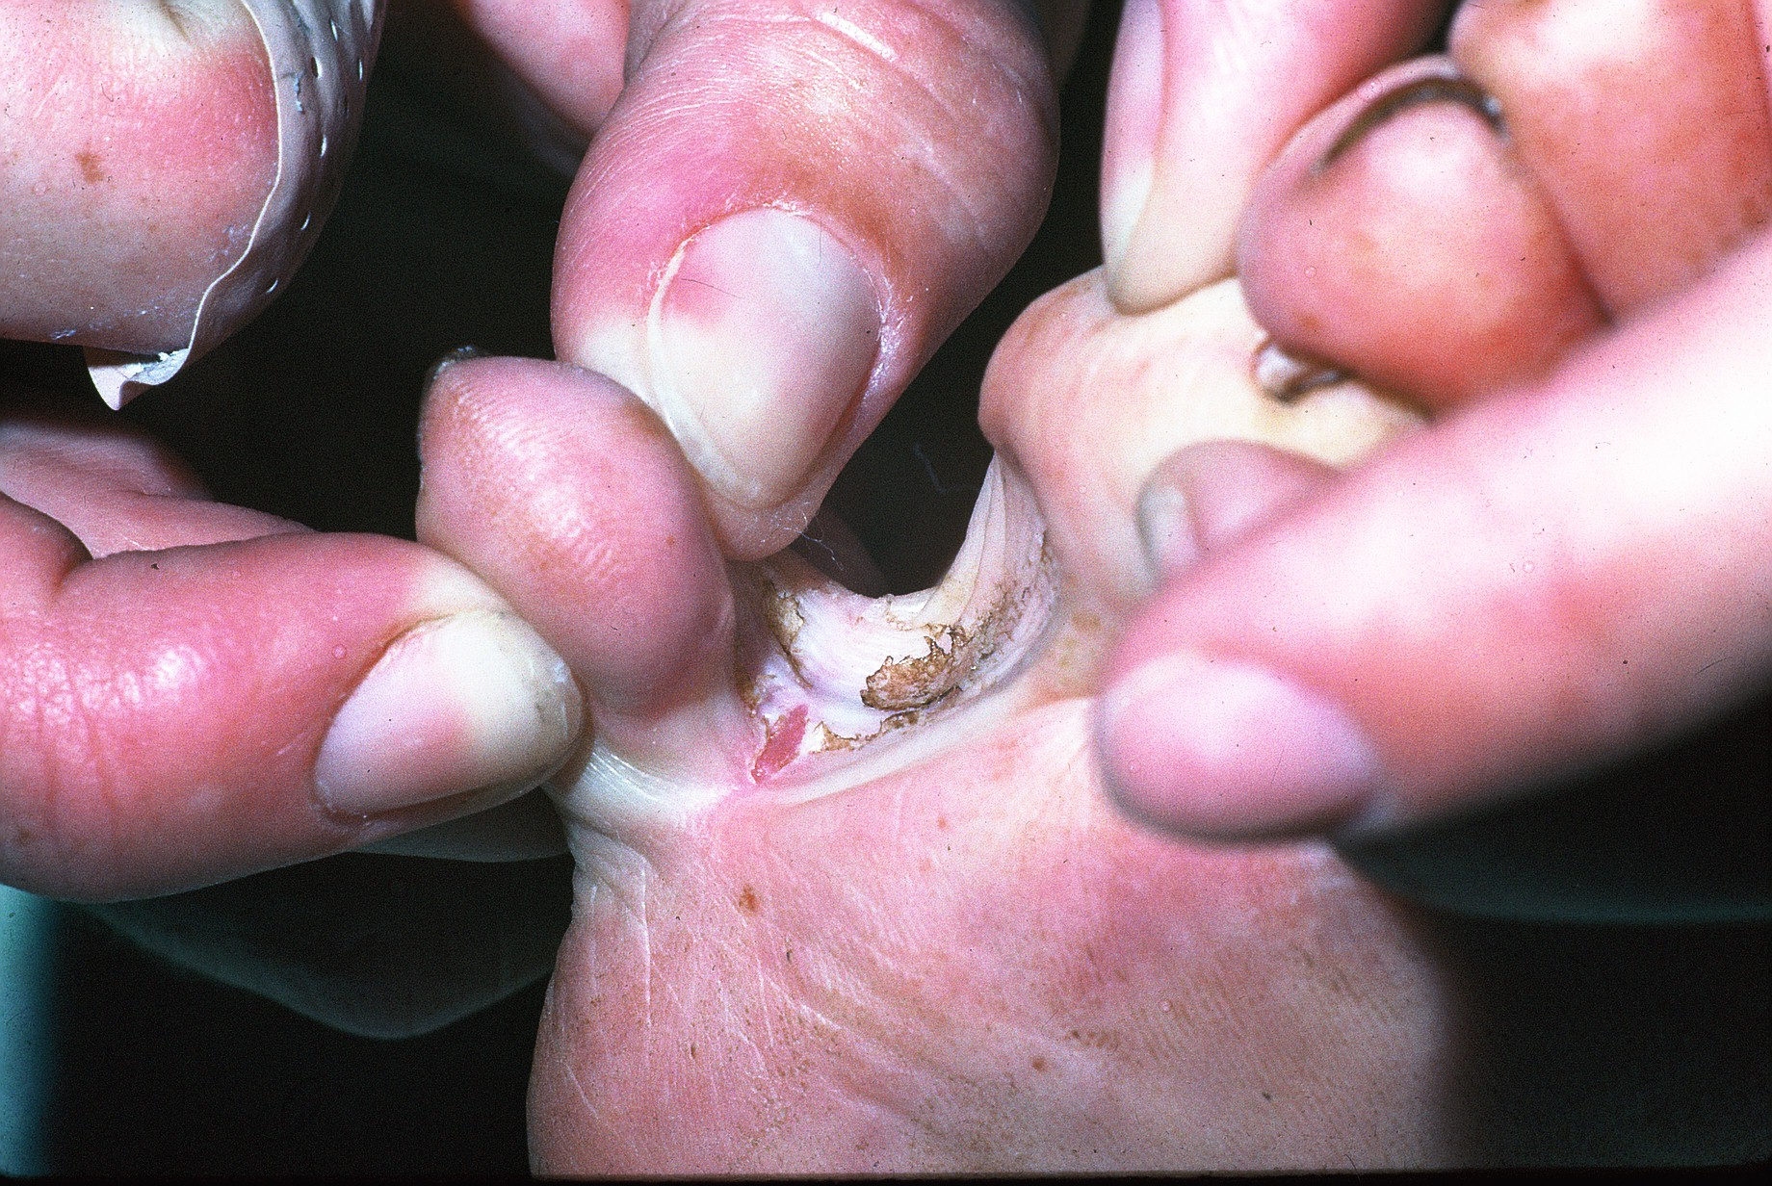
Skin Disorders

Slide 36
Skin disorders

Slide 37
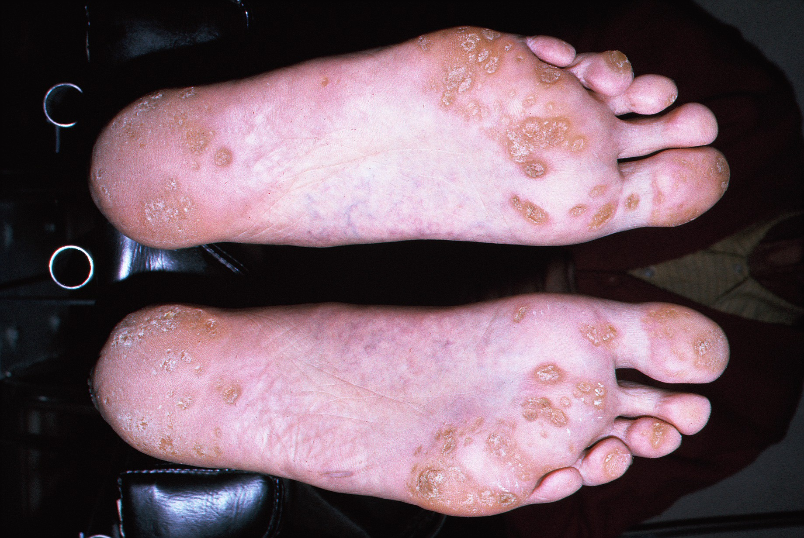
Skin Disorders

Slide 38
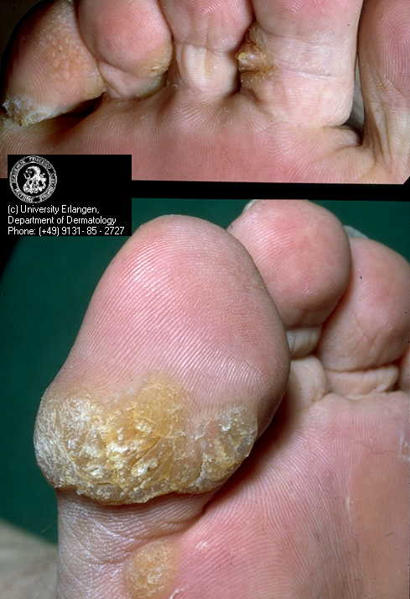
Skin disorders

Slide 39
Skin disorders

Slide 40
Other signs and Symptoms
Color changes to the feet or legs
Any discharge
Swelling, hotness, cracks or bruises

Slide 41
Red Flags for referral
Following requires urgent action and GP referral
Red
Hot
Swelling with pain
Pus
Large sores
Oozing sores

Slide 42
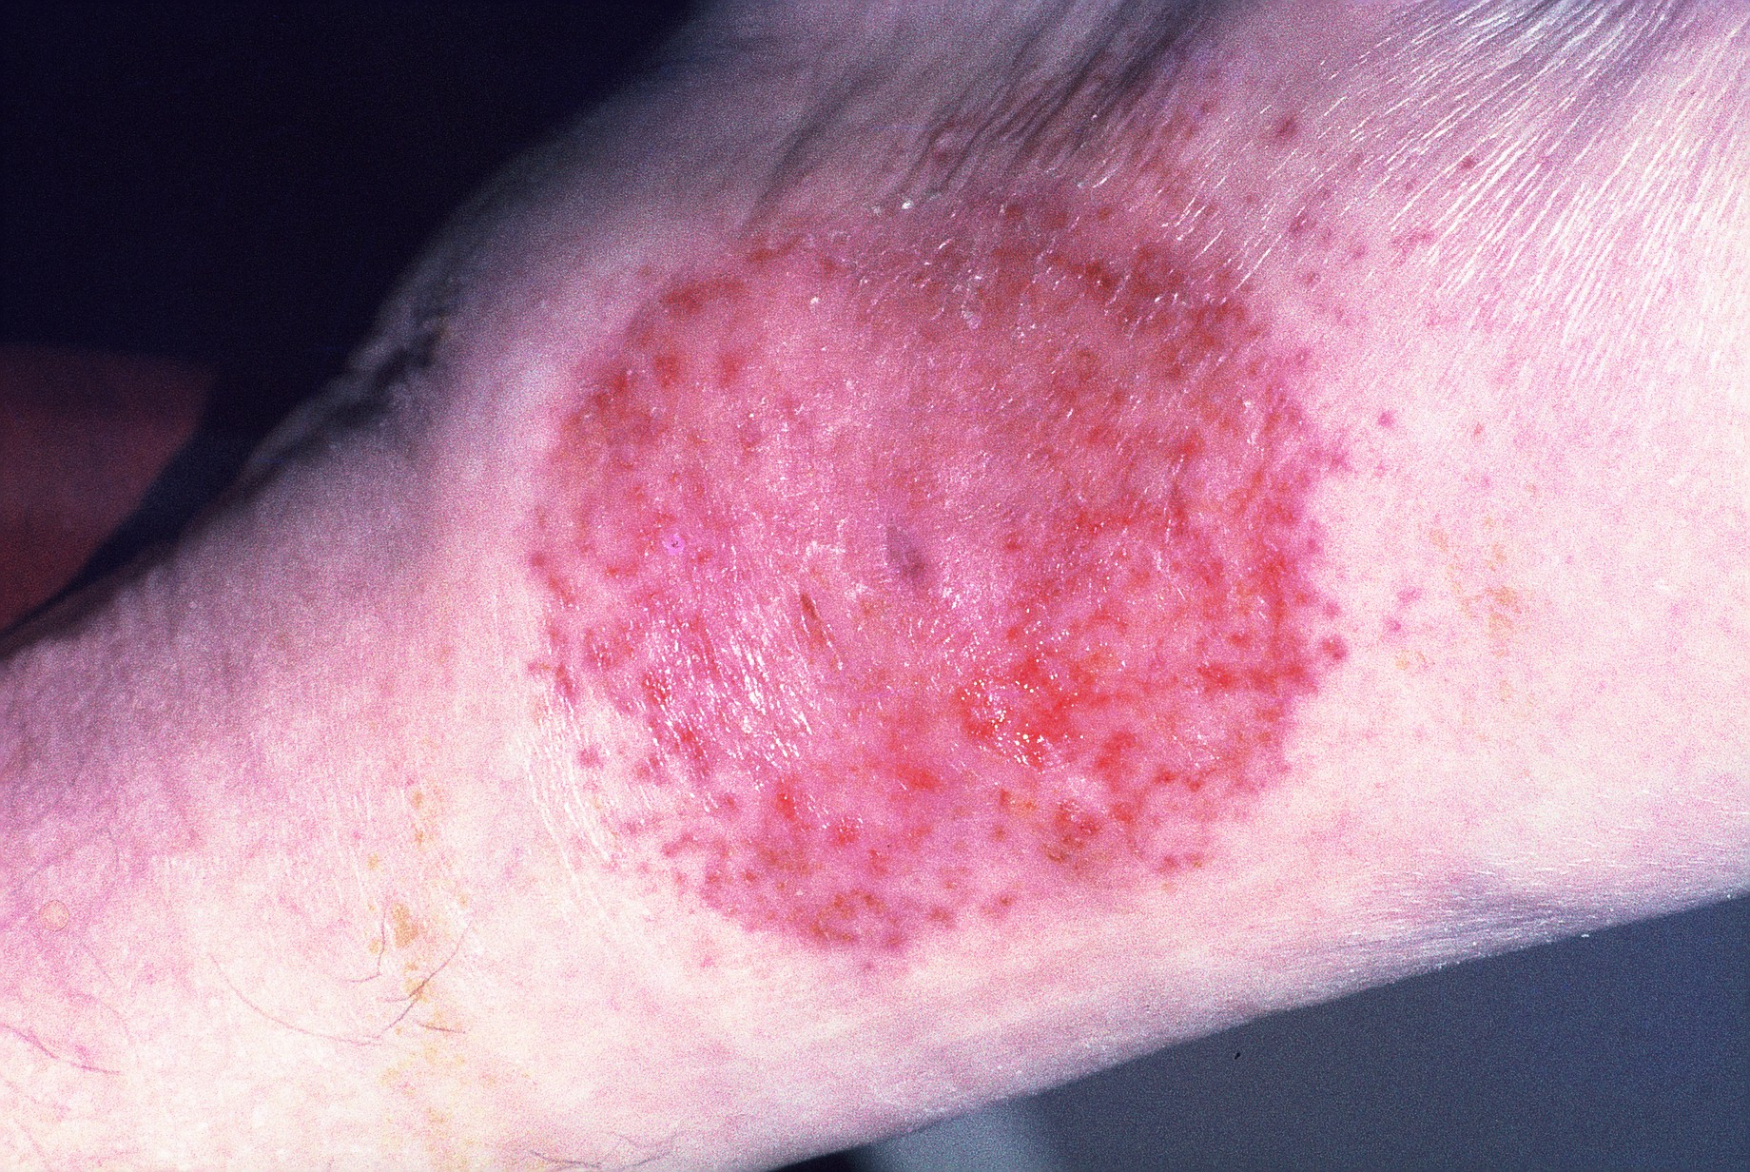
Other Signs and Symptoms

Slide 43
Other signs and symptoms

Slide 44
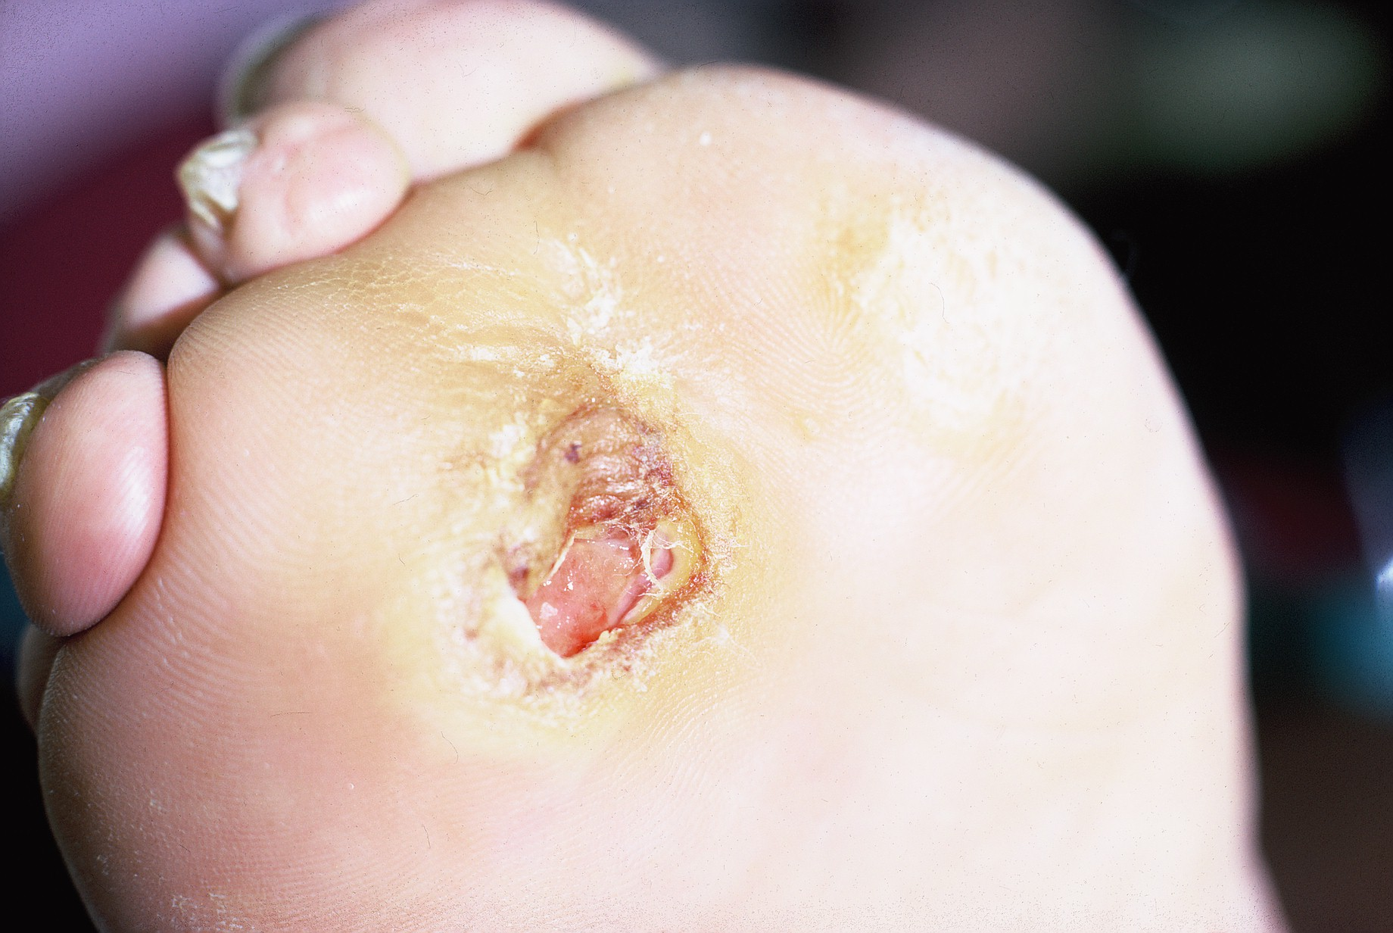
Other Signs and Symptoms

Slide 45
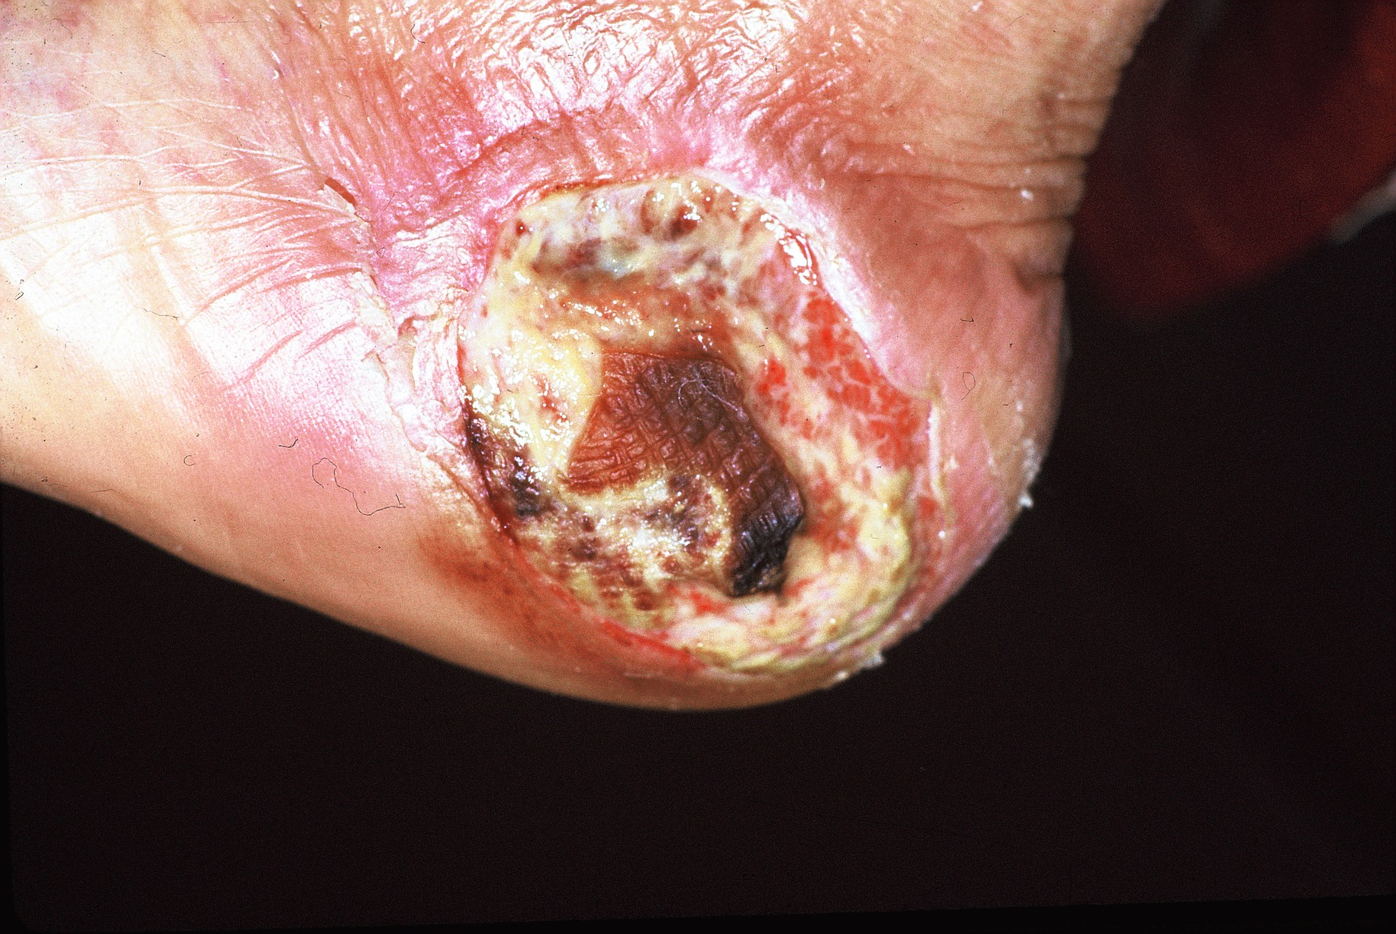
Other Signs and Symptoms

Slide 46
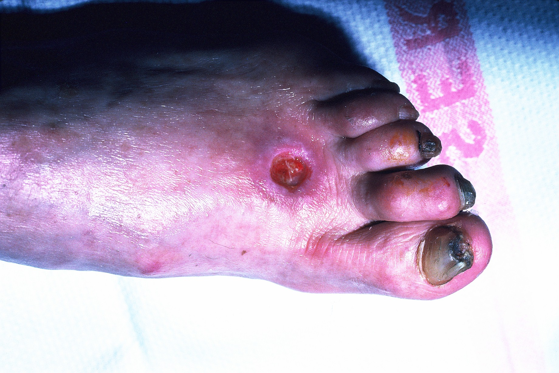
Other Signs and Symptoms

Slide 47
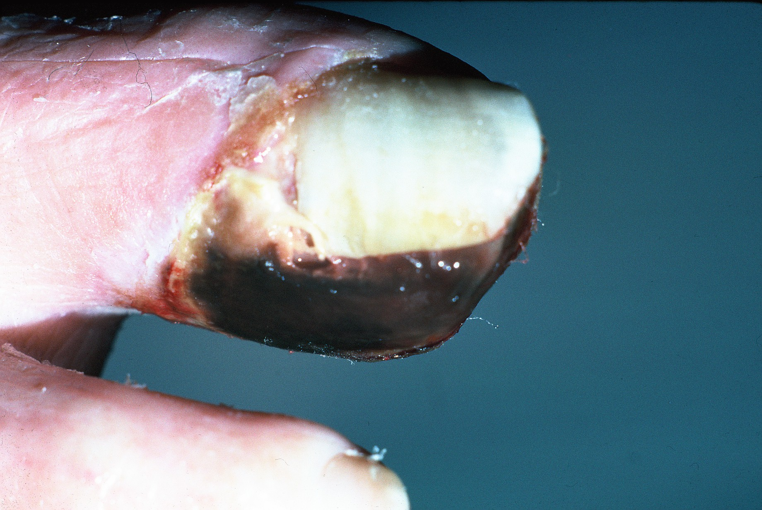
Other Signs and Symptoms

Slide 48
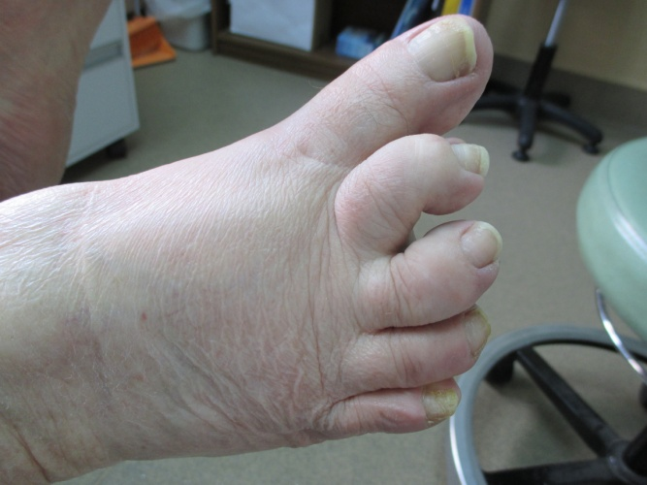
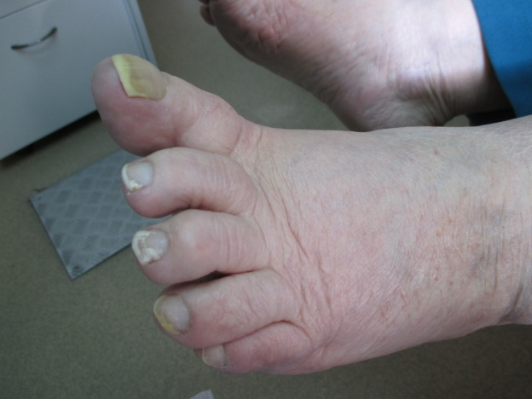
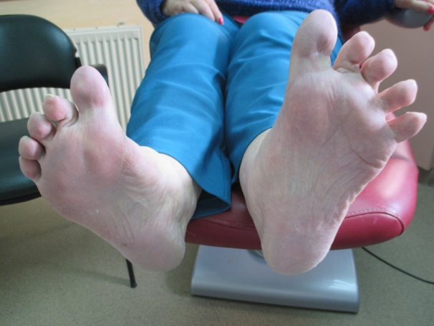
Case Study 1
Mrs B has trouble with bending to cut her nails. She has well controlled diabetes and walks regularly. She finds her nails grow quickly and cut holes in her socks and she has trouble in getting shoes to fit her feet comfortably.

Slide 49
Case study 2
Mr O has regular podiatry for nail care and he is treating a fungal nail with Teatree Oil under podiatrist advice. He also has trouble with webspace tinea & cracks. When a painless blister & bright red swelling formed over his toes his GP sent him immediately to ER where he was admitted to hospital for several days on a drip

Slide 50
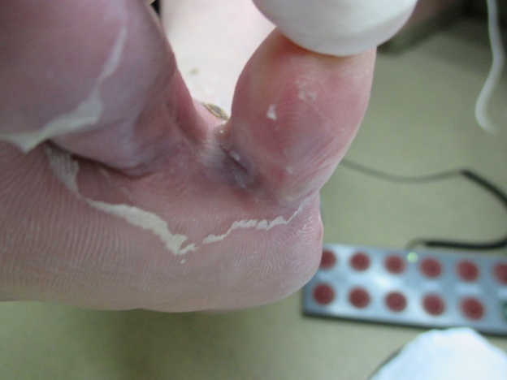
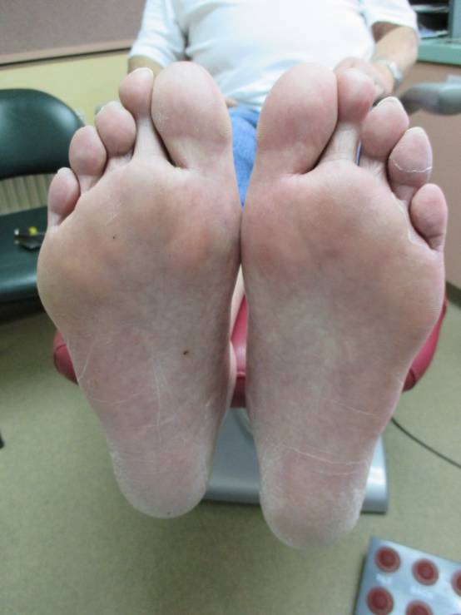
Case study 2

Slide 51
Client Managed Foot Care Role of Community support Workers (CsW)
Support client to maintain basic foot hygiene/healthy feet
Within an Active Support Framework – Do With, Not For
Prompt client to identify techniques for caring for their feet
Assist set-up as required to enable client to undertake foot care
If client is having difficulty performing foot hygiene tasks CSW to prompt client to try different ways of doing it. May need adapted equipment
To inform assessment worker if client is no longer able to complete basic foot hygiene and maintain healthy feet independently
Work with client to complete the screening tool to identify any foot problems
Identify and report any changes in foot condition that may indicate a foot problem that needs to be assessed by a podiatrist

Slide 52
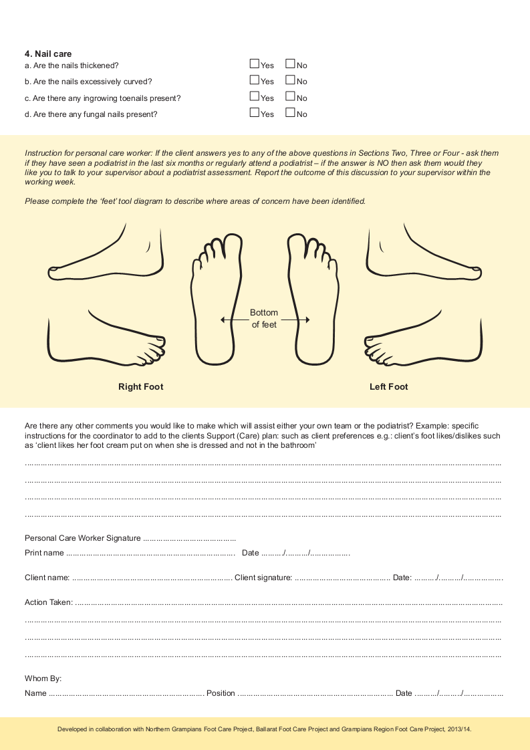
Foot care project screening tool

Slide 53
Screening tool
Activity: Practice using screening tool with a colleague

Slide 54
Summary and questionnaire
CSW supports client in self management of foot care
Work with client to complete foot screening tool
Report any condition of concern immediately to supervisor (See red flags)
Inform assessment worker if client no longer able to complete basic foot hygiene
Implement care plan under direction of podiatrist as requested

Slide 55
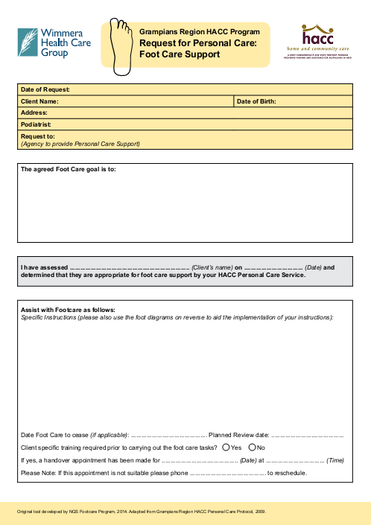
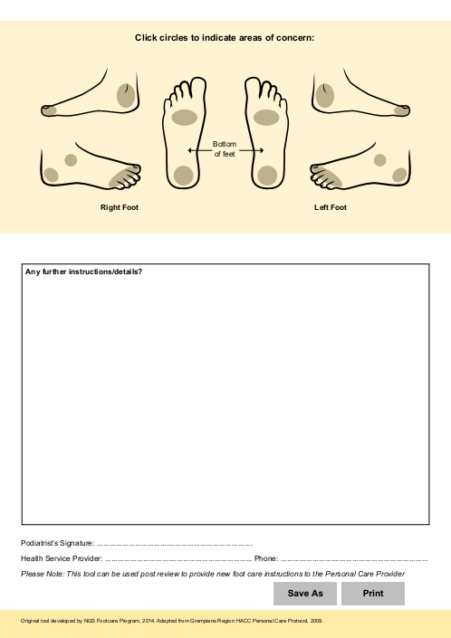
Foot care support under podiatrist direction

Slide 56
QuestionS and QUESTIONNAIre
Questions?
Please complete the participant feedback form before you go!

