Slide 1
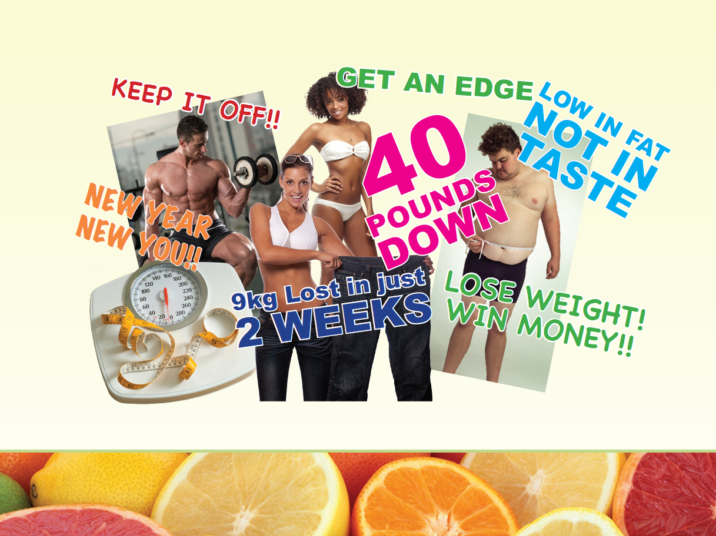
Grampians Region Allied Health Forum – 17th October 2017
Notes:
When people sign up for nutrition training they often believe they will be going away with more knowledge about weight loss and other diets.
We are bombarded with the types of messages we see on this slide- and this is masking another serious issue that our communities also face- malnutrition.
This training will not focus on the messages we see above, instead we will learn about nutritional risk at an older age, and discuss how weight loss and dieting is often not appropriate at an older age.

Slide 2
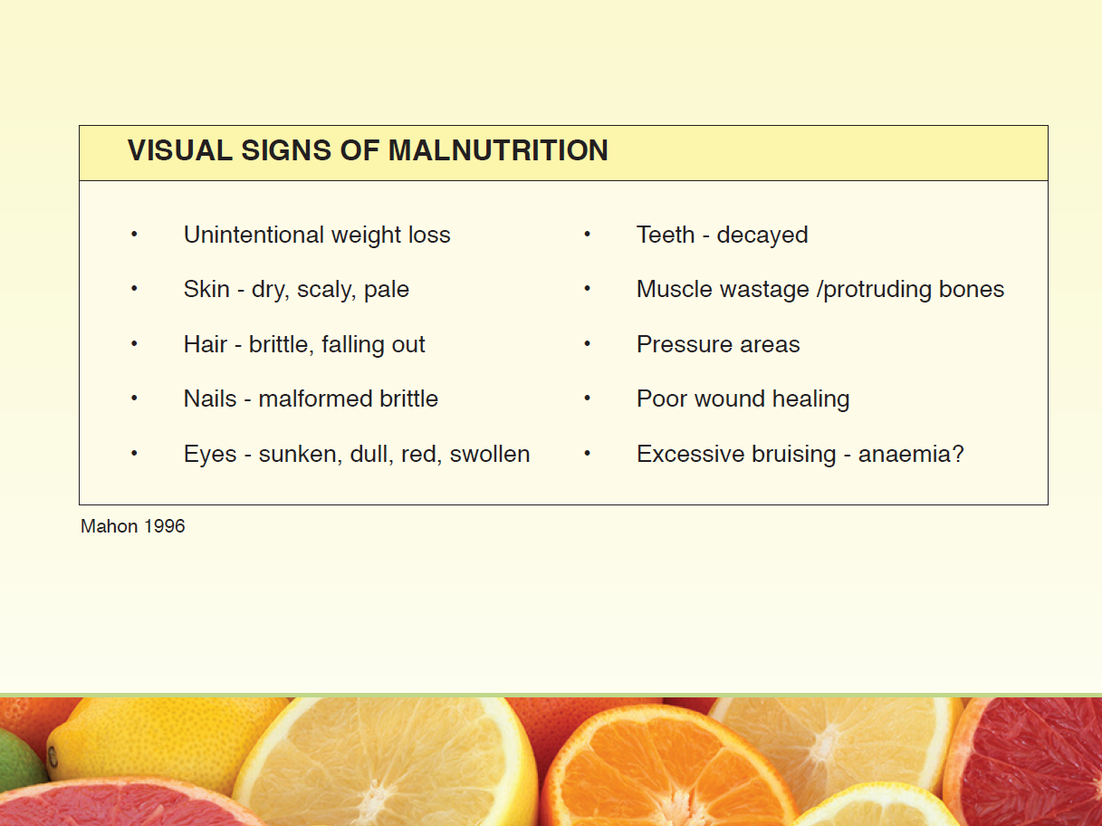
ADAPTED BY:
Amy Trotter (Dietitian) | Ballan District Health and Care
Alicia Shirley (Dietitian) | West Wimmera Health Service
Natalie Sutton (Dietitian) | Wimmera Health Care Group
Joanna Poon/Ashley Webb (Dietitian) | Ballarat Community Health

Slide 3
Today’s Training
Session One | The role of nutrition in older people:
Session Two | Identifying nutritional risk
Session Three | Nutrition interventions
Session Four | Investigating Capacity to Access Nutrition

Slide 4
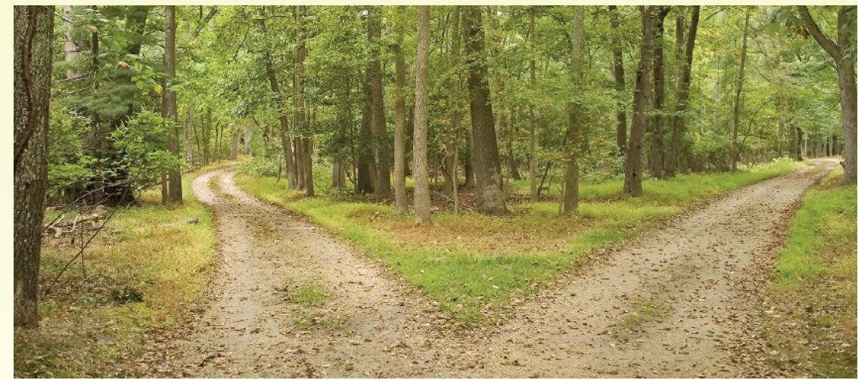

Notes:
The training today aims to enhance your understanding of the importance of nutrition in everyday life and the role it plays in maintaining older peoples independence.
It should also empower you to identify individuals at risk of poor nutrition and in making positive changes to improve their health and wellbeing.
Unfortunately, studies show a large proportion of people at nutritional risk are going undetected because of poor screening and referral practices. The prevalence rate of malnutrition for older people living in the community has been reported to be as high as 30%. In acute and residential aged care facilities prevalence rates are even higher at 50-70%.
In this training we will be presenting a tool that will help guide you through the process of identifying people at nutritional risk and assisting them with the most appropriate intervention.

Slide 5
Session One
The role of nutrition in older people
Presented by: Alicia Shirley

Slide 6
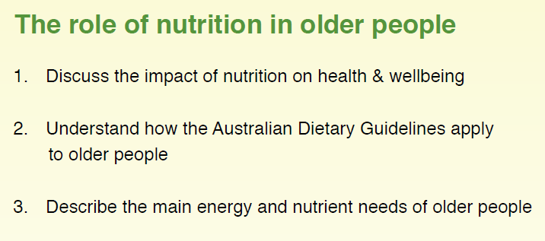
Notes:
3 main learning outcomes from session 1:
Discuss the impact of nutrition on health and well being
Understand how the Australian Dietary Guidelines apply to older people
Describe the main energy and nutrient needs of older people

Slide 7
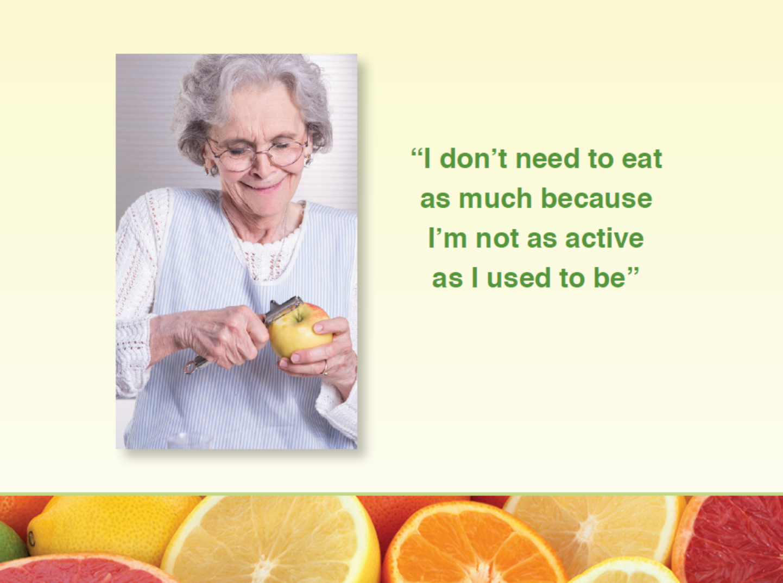

Slide 8
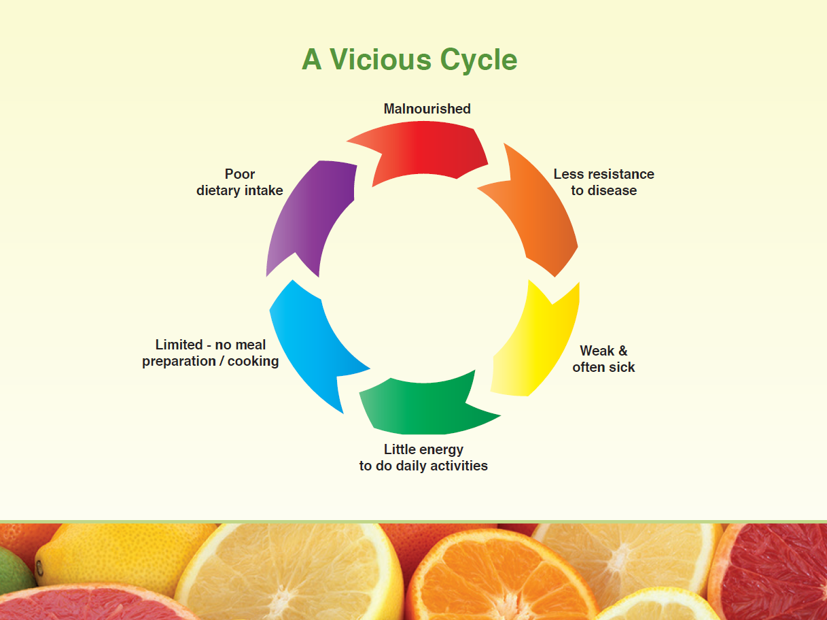
Notes:
The vicious cycle demonstrates the many links between nutrition and health and well being
It is very important to identify those at nutritional risk at an early stage, to prevent them ending up in a vicious cycle that is difficult to get out of
Also other similar factors that create a vicious circle- lonely/low social connections→ reduced appetite or willingless to cook→ poor intake→ wt loss → less resistance to disease → lack of energy to go out → further isolation

Slide 9
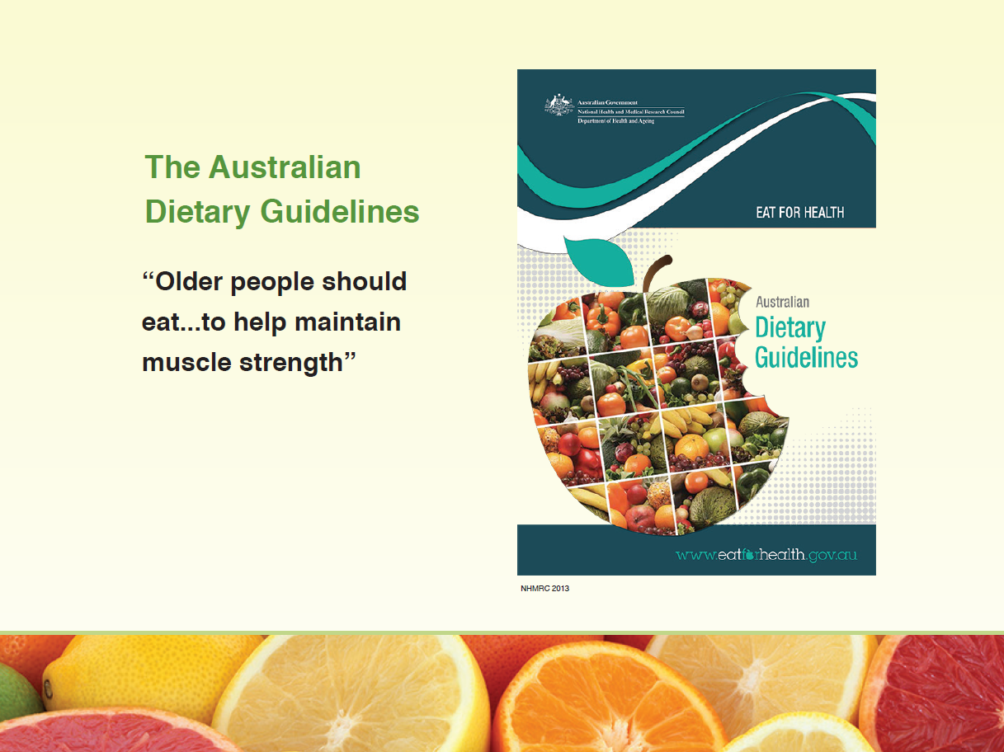
Notes:
The ADG are a general set of guidelines for the entire population – with special considerations for children and older people
For Older people who are well, the ADG emphasize eating nutritious food and keeping active to maintain muscle strength and the ability to carry out functional tasks
These guidelines DO NOT apply to people with special medical condition requiring specialised dietary advice, including frail, elderly people at risk of malnutrition
This target group often require individual assessment and advice by an APD

Slide 10
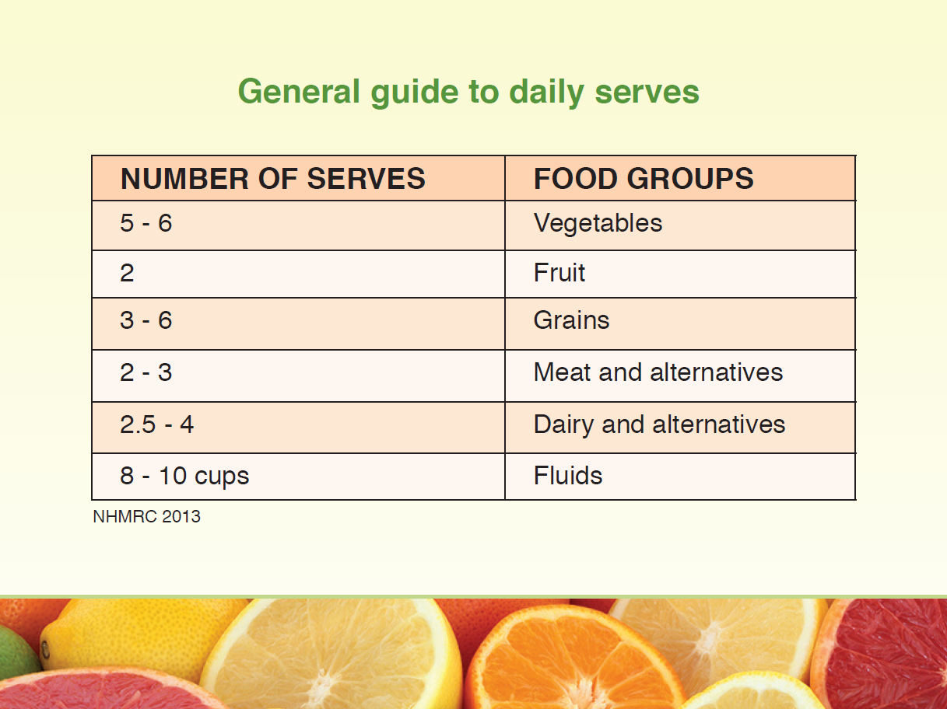
Notes:
Use Eat for Health brochure
Use food models to visually show portion sizes
Fluids are not part of the core food groups; they are an important component of a healthy diet
In older people, inadequate fluid intake can have significant consequences including: constipation, cognitive impairment, functional decline, falls and stroke
Fluids include all drinks – not just water

Slide 11
Notes:
To ensure a good balance of the different food groups, we encourage people to aim for their main meal to resemble portions shown on the plate
Those who receive MOW are at risk of not getting a good balance of foods because they split their 3 courses over 2 meals without adding extra
This results in a very inadequate intake, as the 3 course meal is designed to meet about 1/3 of their daily requirements
If someone insists on splitting their meal, some added extras may include: having a milk drink or a dessert with custard or yoghurt with the main meal; and a sandwich with the soup and dessert

Slide 12
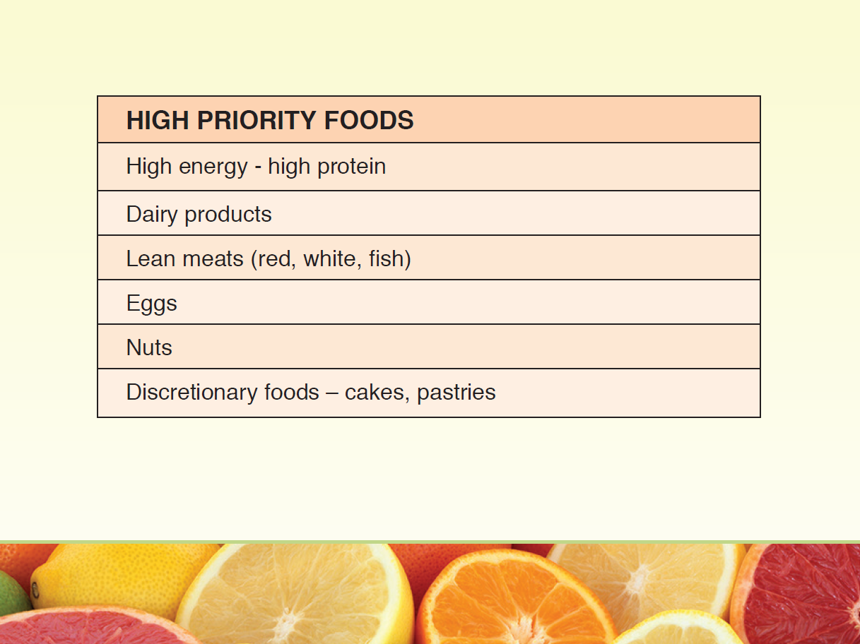
Notes:
When people aren't eating well Dietitians help maximise their intake of high energy and high protein foods
Without enough energy and protein from the diet, the body will start breaking down its own stores, and this is how weight and muscle loss occurs
Good sources of energy and protein are found especially in the dairy, meat and alternatives food groups

Slide 13
Dairy Products
Notes:
Dairy products provide a good source of many nutrients including calcium, protein, iodine, vitamin A, vitamin D, riboflavin, vitamin B12 and Zinc
Calcium has an important role in supporting bone structure and strength as well as nerve and muscle function
Older adults need between 1000-1300mg of calcium per day
A serve is approximately 300mg
One serve = 1 glass milk (250mL), 2 slices hard cheese (40g) or 6 oranges or 1kg broccoli
Other calcium sources include: calcium enriched non dairy milks, bony fish like sardines and salmon, some nuts and fortified breakfast cereals.
One reason older people may choose not to eat dairy products, is lactose intolerance. Lactose is the naturally occurring sugar in dairy foods. As we age, our bodies may start to produce less of the enzyme that breaks lactose down, and as a result we may have unwanted gastrointestinal symptoms.
There are many lactose free options available which provide the calcium and protein of the standard dairy products.

Slide 14
Meat and Meat Alternatives
Notes:
Meat and meat alternative food group traditionally known as protein rich group
These foods also provide other important nutrient's such as iodine, iron, zinc, vitamin B12 and essential fatty acids
Protein is the building block of the body – needed to maintain muscle mass and strength
Our protein requirement increases as we age
A reduced protein intake combined with a reduced energy intake can result in muscle wasting and malnutrition
Protein requirements are dependent on age, gender, weight and certain conditions such as cancer and wound healing
A serve of protein (as per the AGHE) contains 20g of protein – ie. 65g red meat, 80g chicken, 100g fish
To get the equivalent from other food groups: 2 sups milk, 1.5 cups baked beans, 3-4 large eggs, 8 wholemeal bread, 40 mushrooms, 6 whole cabbages, 76 applease or 3 tbs of complete supplement with 200ml milk

Slide 15
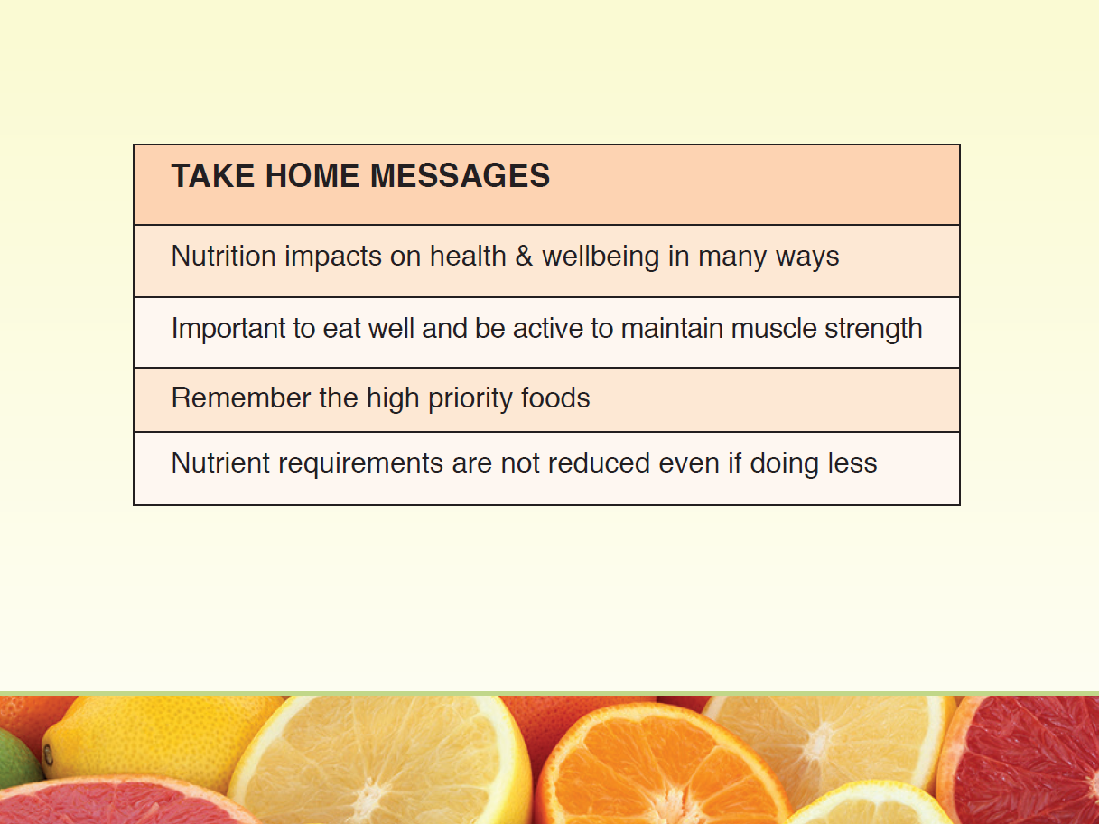
Notes:
Nutrition impacts on health and wellbeing in many ways – important to ensure that clients are getting adequate nutrition for good health and are able to take part in accessing it, and maintains connections to food that are important to them
Important to eat well as per ADG – place an emphasis on maintaining muscle strength, not just weight
Remember the high priority foods
Nutrient requirements are not reduced even though they maybe doing less physically, some nutrients increase with age
You can do something about improving nutrition in older people – being aware of the role nutrition plays in maintaining a persons independence is important when considering whether to address it or not

Slide 16
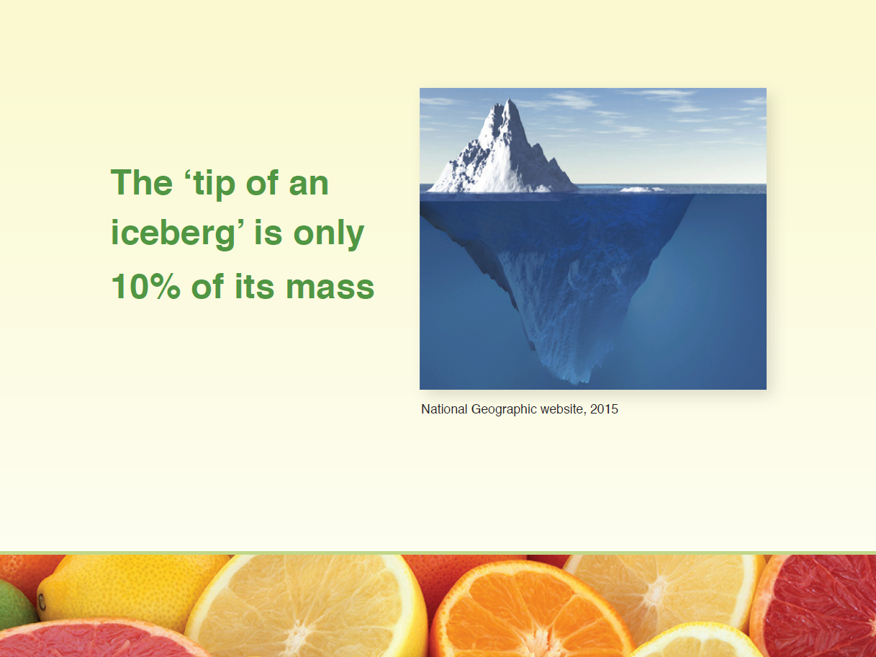
Session Two
Identifying nutritional risk
Presented by: Natalie Sutton
EATING FOR INDEPENDENCE - 2016
ACKNOWLEDGEMENTS
Project Steering Committee
HACC Allied Health past and present
HACC Services Benalla Rural City Council & CHPCP
Research mentors
Hume Region Food Services Group
DHHS Hume Region
Training participants

Slide 17
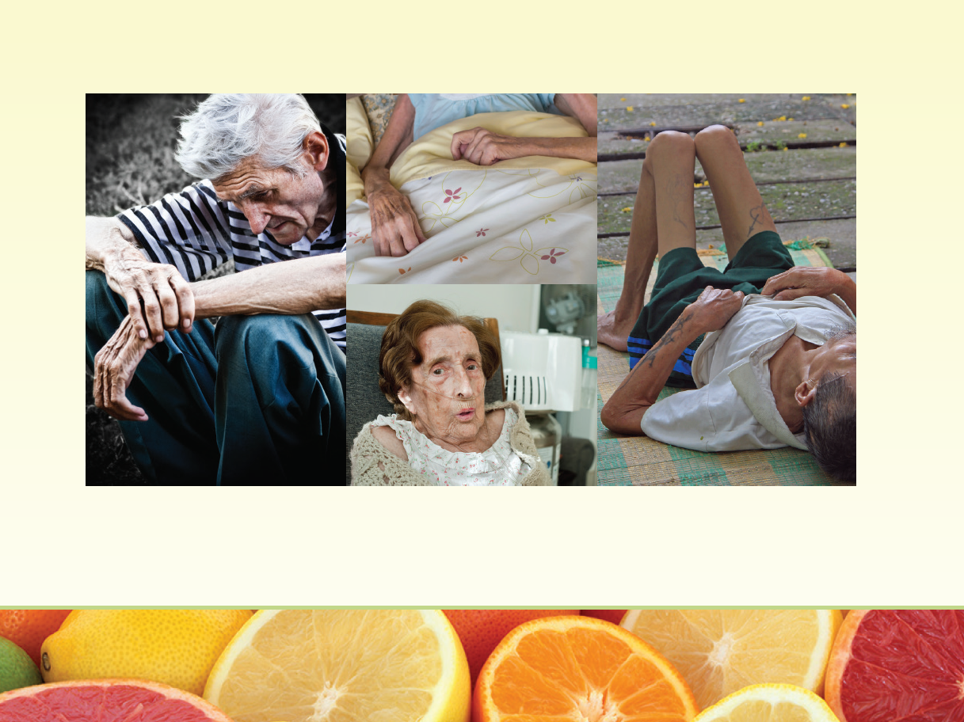
Notes:
Session Two will provide information on identifying nutritional risk. At the end of the presentation will be a case study.
These pictures are often what comes to mind when we think about starvation, people in third world countries and nursing homes. But malnutrition isn’t always as obvious as this and is more prevalent than we think. Unfortunately malnutrition is often under-diagnosed, partly due to poor screening tools or practices.

Slide 18
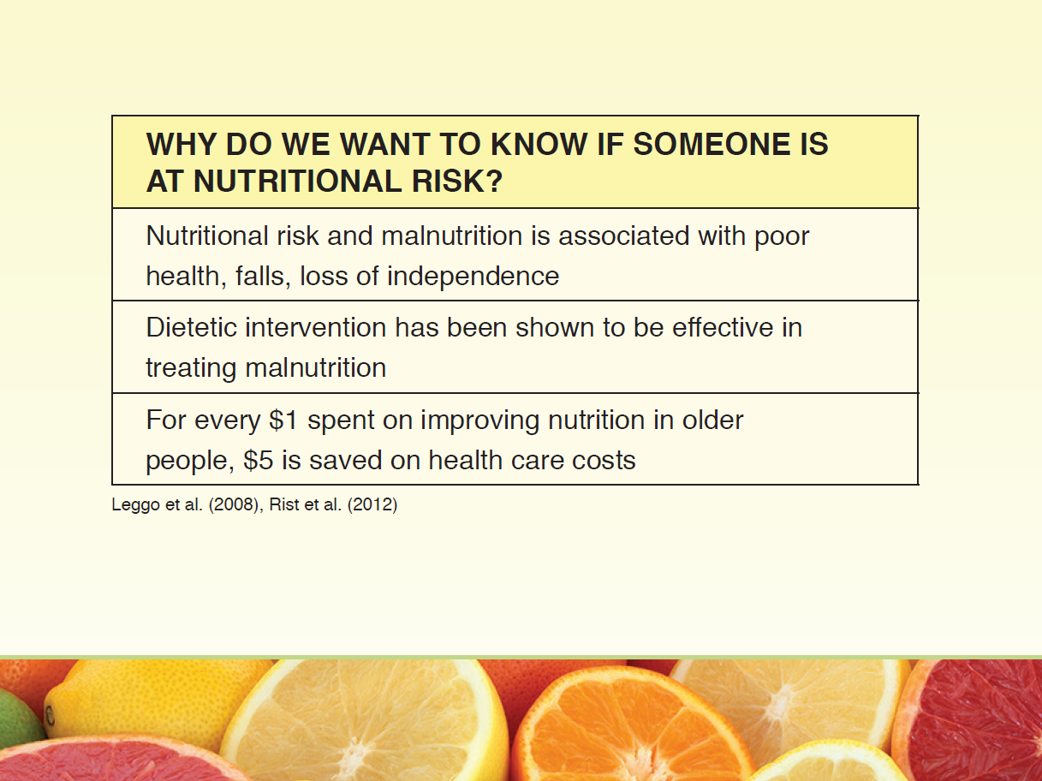
Notes:
Studies have shown that malnutrition in older people is associated with poor physical function and disability, decline in muscle strength, falls, pressure ulcers, infections and other health problems. Therefore a higher level of care is required, which results in significant healthcare costs.
But because of many perceived barriers to routine screening, such as not having enough time or support, many people who are malnourished or at risk, go un-detected by community services.
Preventing and treating malnutrition in the community is worth a significant cost saving. It has been estimated that for every dollar spent on improving nutrition in older people, $5 is saved in health care costs.

Slide 19
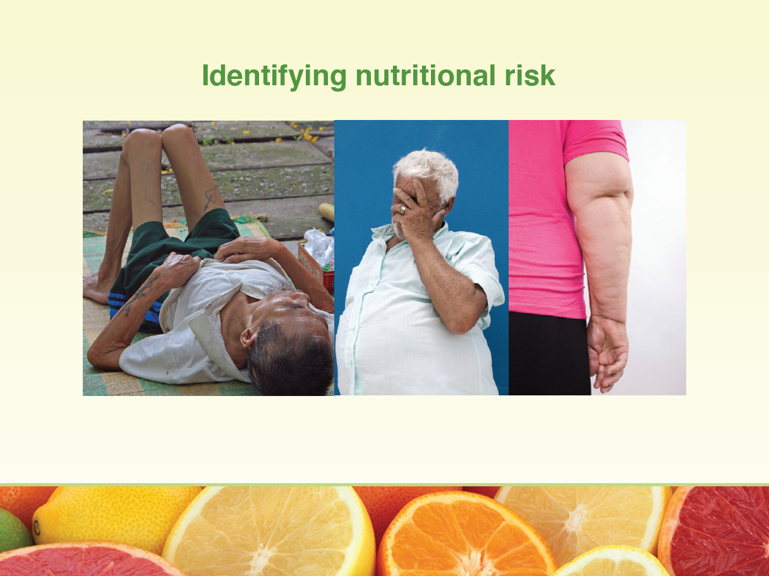
Notes:
How would you know if you client was at nutritional risk? Would a person like this come to mind? (click for first photo)
How about these people? (click for next photo)
Both examples could be people at nutritional risk. Nutritional risk can include someone who is underweight or overweight, someone with low muscle mass or an inadequate intake of nutrients.

Slide 20
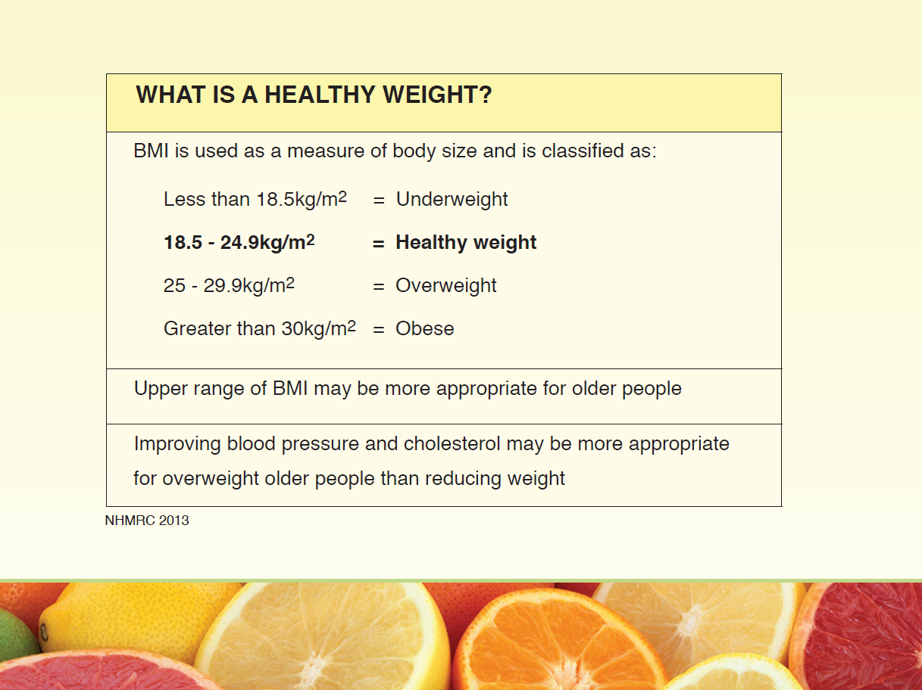
Notes:
Before we establish how to identify if someone is malnourished or at nutritional risk, it is important to understand what a well-nourished status is for older people.
The most common approach to assessing weight is to use Body Mass Index (BMI) which is a measure of a person’s weight and height. These are the general ranges of BMI, The Australian Dietary Guidelines mention that for older people, being underweight may be more harmful than being overweight and that a different, higher BMI range may be more appropriate for people over 70 years. However due to different interpretations of research, this message is not universally accepted.

Slide 21
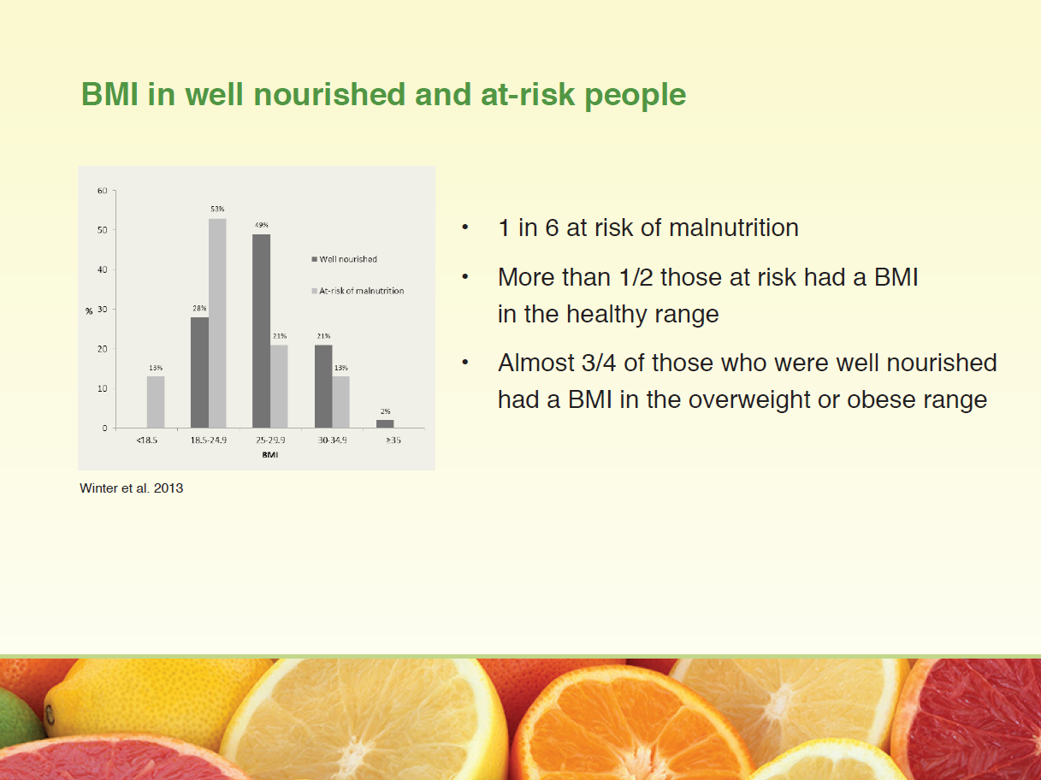
Notes:
This is just an example of a study which found that a higher BMI in older people may be more appropriate. It’s a Victorian study which aimed to determine the prevalence of malnutrition in older people who were attending their GP clinic.
In this study they used a validated method for screening for risk of malnutrition (MNA-SF), approximately 1 in 6 (17%) were identified at risk of malnutrition. Yet of these people, more than half (53%) had a BMI in the healthy weight range. Of the people considered well-nourished (83%), almost ¾ (72%) had a BMI in the overweight or obese category.
This study demonstrates that simply observing an older person’s body weight or calculating their BMI does not provide an adequate reflection of their nutritional status.

Slide 22
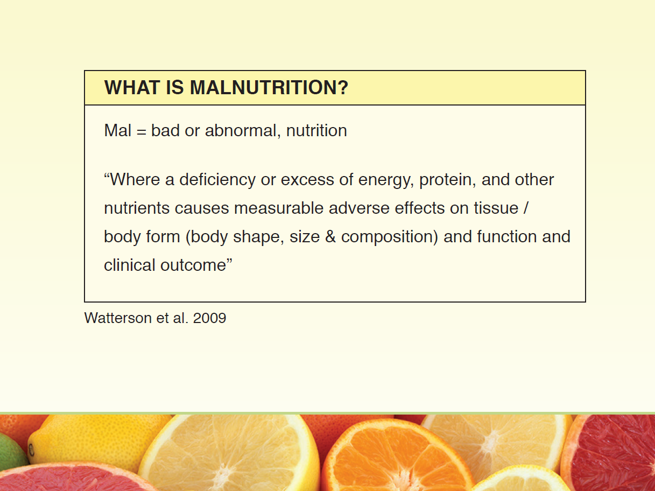

Slide 23
Signs of Malnutrition
Visual | Non Visual
Unintentional weight loss | Poor mental health/depression
Skin – dry, pale, scaly | Muscle Weakness
Hair – brittle, falling out | Fatigue, dizziness
Teeth – decayed | Frequent infections
Pressure areas | Chronic diarrhoea
Muscle wastage/protruding bones | Bone and joint pain
Poor wound healing
Signs of Malnutrition
Notes:
These are common outward/visual signs of malnutrition and some less obvious non-visual signs. These non-visual signs can make it difficult to diagnose someone with malnutrition therefore further investigation is required, such as the use of screening tools. Screening tools can not be used to diagnose someone with malnutrition, but they are useful for identifying people who are potentially malnourished or at risk.

Slide 24
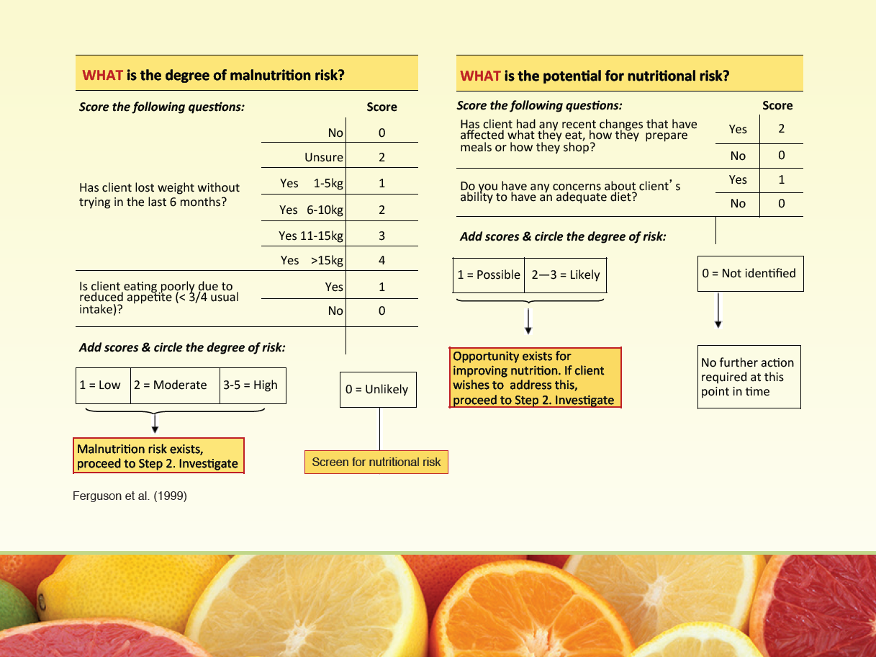
Nutrition Screen
ICAN: Investigating Capacity to Access Nutrition
Notes:
We have found that most assessments performed in community setting include questions around a person’s food intake to determine if they are having an adequate diet. Some of these methods have not been properly tested to ensure they accurately identify people at risk.
The Malnutrition Screening Tool (MST) is favoured because:
-it is easy to use, no calculations
-quick to use
-tested in a range of settings and determines degree of risk
MST on its own identifies clients at highest risk. In this new screening tool there are additional questions which will pick up people exhibiting early signs of nutritional risk. However these questions require further research to test their effectiveness.
The MST and additional questions have been put into a screening and referral pathway called ICAN. The MST and additional questions form the first, screening part of the ICAN.

Slide 25
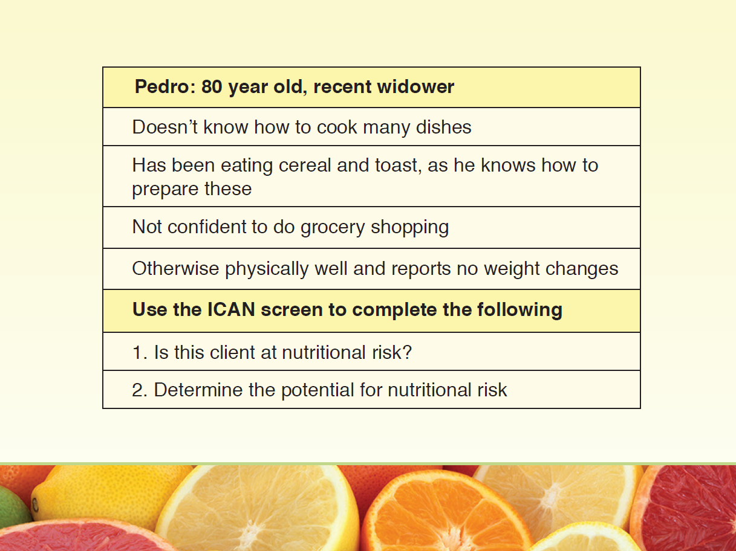
Notes:
Use this case study to practise using the Nutritional Risk Screen to determine the potential for nutritional risk. Discuss in groups using the ICAN given to you, only completely the first, screening part.
Using the first part of the ICAN screen this client is not at malnutrition risk since he hasn’t lost weight and doesn’t appear to have a reduced appetite. Moving to the next screen, the question is whether Pedro has had any recent changes that have affected what he eats or how he accesses meals and groceries.
Pedro would score a 2, since his partner has recently passed away and it appears his partner prepared meals and shopped.
The next question is whether there are any concerns about Pedro’s ability to have an adequate diet. You might give Pedro a 1 since he doesn’t know how to cook much, he’s not confident to go shopping and not eating a lot of variety.
TOTAL: 3. The potential for Pedro to be at nutritional risk is LIKELY.

Slide 26
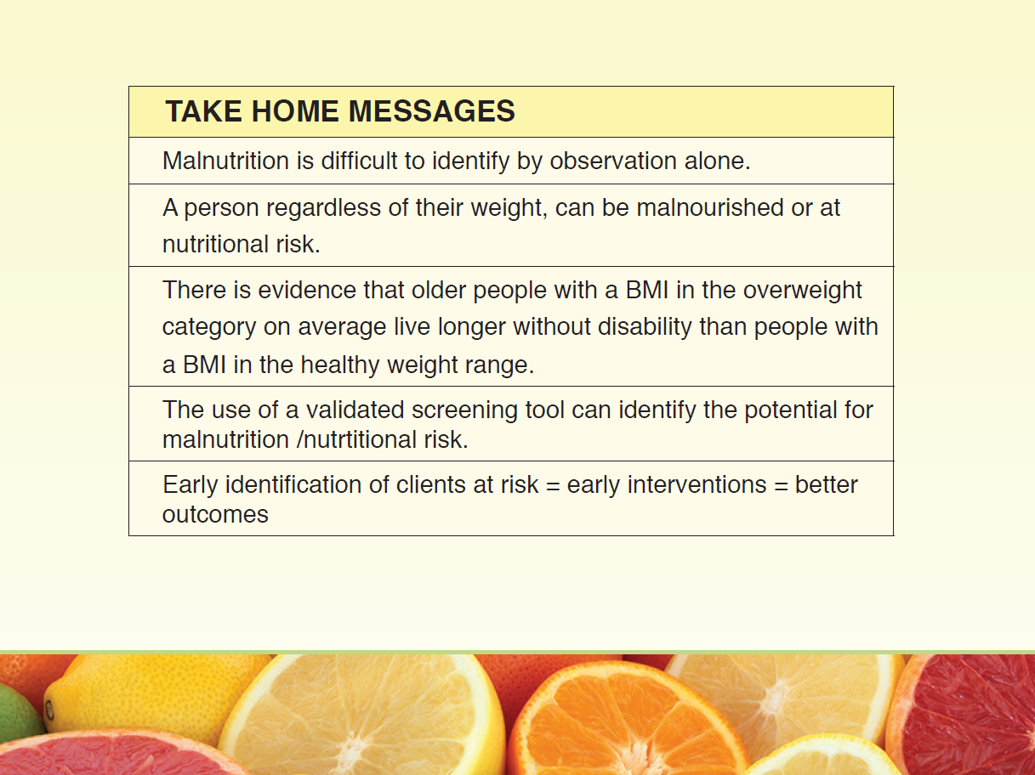
Notes:
It is difficult to identify malnutrition and nutritional risk simply by observing a person’s weight status therefore it is important to use a validated screening tool, such as the MST.
A person regardless of their weight can be malnourished or at nutritional risk. There is evidence that older people with a BMI in the overweight category on average live longer without disability than those in the healthy weight range.
The earlier a person is identified at risk, the more likely interventions will have good outcomes.

Slide 27
Session Three
Nutrition Interventions
Presented by: Alicia Shirley
EATING FOR INDEPENDENCE - 2016
ACKNOWLEDGEMENTS
Project Steering Committee
HACC Allied Health past and present
HACC Services Benalla Rural City Council & CHPCP
Research mentors
Hume Region Food Services Group
DHHS Hume Region
Training participants

Slide 28
Notes:
When you have identified that a person is at nutritional risk, the next step is to think about how we as allied health practitioners can support them, to maintain as much of their independence as possible-
-the level of support needed will differ between individuals.
Some people may be extremely independent to the point they wish to continue to grow their food, while others depend on regular assistance to achieve adequate intake.
It is important to remember- food is not only needed for sustaining life, but it also has a role in defining a persons identity, their culture and life experiences. Simply providing a meal to a person will not always fulfil these other roles.
Nutrition issues in older people are quite often addressed through services such as Meals on wheels, social supports and/or shopping assistance. These are excellent services but we need to think about the bigger picture- which is why they are having difficulties accessing nutrition in the first place? What can allied health do to help regain the best level of independence?

Slide 29
Introduction to Allied Health:
Dietitian
Occupational Therapist (OT)
Physiotherapist (PT)
Speech Pathologist

Slide 30
Notes:
What do dietitians do?
-offer health advice
-support skill building
-promote emotional wellbeing
Unfortunately, Its not uncommon for clients to decline a dietitian referral, often related to the negative connotations around the word diet it dietitian.

Slide 31
Notes:
Dietitians offer health advice on topics such as
General healthy eating- Australian Guide to Healthy Eating- for age, gender, physical activity levels.
Adivce on how to manage acute and chronic conditions from a diet point of view, which is generally in conjunction with other treatments.
- high cholesterol
- high blood pressure
- Overweight and obesity
- Diabetes
Some conditions may alter nutrition needs- ie. They actually increase the body’s need for energy and protein, and other nutrients. If these needs are not met, the persons nutrition status and health may be compromised. Extra nutrition is required for Meeting extra demands
- wound healing
COPD
Cancer
Parkinsons and MND
Various gastrointestinal disorders
From here we think about strategies- how can our clients, at varied levels of independence, achieve our nutrition goals and recommendations?

Slide 32
Notes:
Dietitians support clients to build skills around meal planning, food budgeting, making healthy food choices when grocery shopping, reading food labels, cooking and following recipes- considering their level of skills, interest and abilities.
Dietitians may be able to do home visits, which allows them to provide practical assistance.
Family, friends and community workers or allied health assistants may also assist ongoing monitoring and skill development.
Depending on the level of independence, skills and physical capabilities, a dietitians role in supporting skill building may be in joint effort with another allied health practitioner- which I will expand on shortly.

Slide 33
Notes:
Dietitians promote emotional wellbeing by encouraging eating with others and food enjoyment,- healthy eating behaviours, and lifestyle changes through motivational interviewing and solution based coaching.
In all these interventions and strategies, dietitians aim to empower people to make changes one step at a time (through progressive goal setting).
This includes considering the clients priority goals for nutrition. Dietitians offen get referrals for one issue (for example to lose weight) and through holistic assessment, find more important related concerns, such as for example constipation, which may go onto to affect for example, urinary continence.

Slide 34
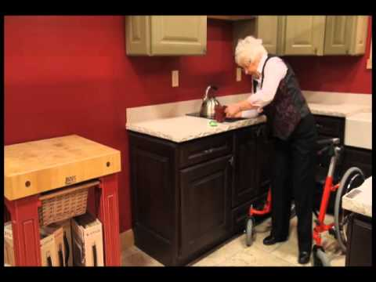
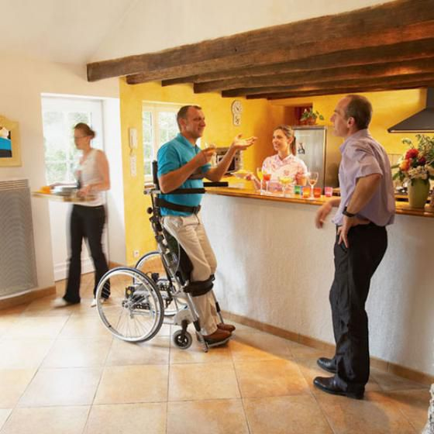
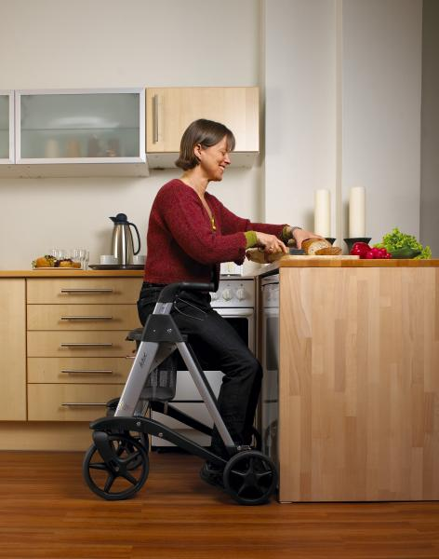
Notes:
Ots are able to build a persons current skills and abilities to access nutrition, and the dietitian can provide further advice alongside these improving skills.
The primary goal of occupational therapy is to enable people to participate in the activities of everyday life, including those that are necessary to achieve adequate nutrition- meal preparation and feeding.
they work with people to enhance their ability to engage in these activities, or modify the activity or environment ( such as modifying the kitchen environment to improve safety, or use of modified cooking or eating appliances and equipment) to better support their independence in such activities- such as shift them from mow to simple cooking

Slide 35

Notes:
What role to you think physiotherapists might have in nutrition?
The goal of physio therapy is to support people to recover from injury, reduce pain and stiffness, and increase mobility.
They can help prevent deconditioning by maintaining physical activity and function. Physical function is an important part of being able to independently access adequate nutrition

Slide 36

Physical issues – what are some of the challenges older people face in their homes
Notes:
Many physical challenges of older people are related to deconditioning and weakness. Just like a lot of older people believe they do not require the nutrition they once did, many also believe the body does not need as much exercise as it gets older- and that fraility and physical weakness is just a part of normal ageing.
So side by side, we see how malnutrition and inactivity both are part of a vicious cycle, and they are very closely linked.
-Being malnourished and inactive,
older people are less resistant to disease and lose muscle mass
→ feeling weak and sick, with low energy levels, wounds may be slow to heal and pain may increase
→ further inactivity including limited meal preparation
→ poor dietary intake

Slide 37
Notes:
Some other factors that may impact an older persons nutrition status are:
-Troubles communicating, may impact a persons ability to access foods they enjoy
-Swallowing difficulties, which may impact a persons ability to eat the foods they would usually choose and enjoy
- Speech pathologists role in nutrition, is to support people to choose, prepare and access enjoyable meals with safe food texture and fluid consistency

Slide 38
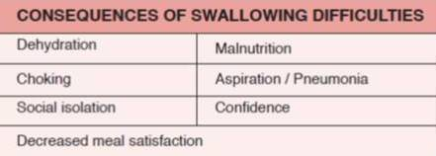

Slide 39
Notes:
Take home messages:
Look at the bigger picture when thinking about strategies to improve nutrition
Improving access to nutrition can be achieve with a range of multidisciplinary strategies- each allied health disciplines role is important
Consider the varying levels of support required to restore a person back to their best level of independance

Slide 40
Notes:
-As demonstrated on this slide, nutrition interventions can range in the level of support they offer.
-Some people will need strategies which enable them to improve or restore their function after a set back,
-Others will require strategies which maintain them where they are at, because they lack capacity for functional gain.
-Moving forward, think about strategies you currently use, and whether they are anyways you could improve your focus toward the big picture, working closely with allied health disciplines towards restorative care.

Slide 41
ACKNOWLEDGEMENTS – EATING FOR INDEPENDENCE PROJECT 2016
Project steering committee
HACC Allied Health past and present
HACC Services Benalla Rural City Council & CHPCP
Research mentors
Hume Region Food Services Group
DHHS Hume Region
Training participants

Slide 42
Session Four
Investigating Capacity to Access Nutrition
Presented by: Natalie Sutton
EATING FOR INDEPENDENCE - 2016
ACKNOWLEDGEMENTS
Project Steering Committee
HACC Allied Health past and present
HACC Services Benalla Rural City Council & CHPCP
Research mentors
Hume Region Food Services Group
DHHS Hume Region
Training participants

Slide 43

Notes:
Like the tip of an iceberg that only shows 10% of its own mass, the obvious signs of nutritional risk are only part of the problem. Without investigating further, it’s difficult to see the bigger picture and therefore come up with the most optimal solution.

Slide 44
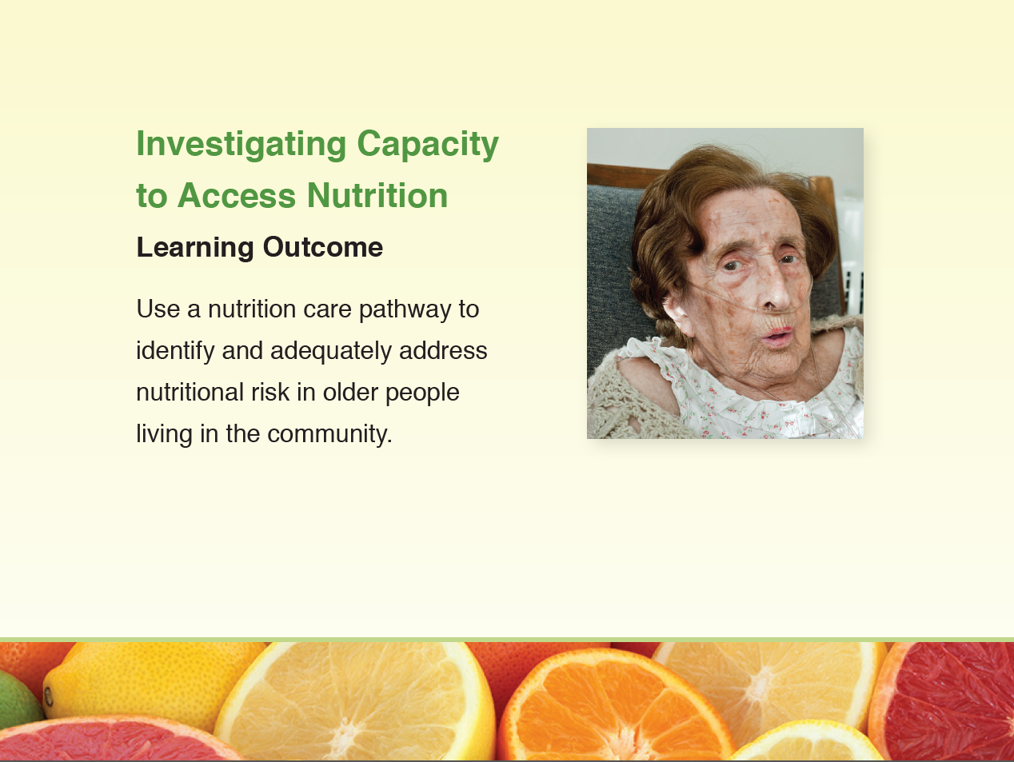
Notes:
Outcomes
In this session we will discuss a case study and by looking a the ICAN tool determine their nutritional risk and any further actions that are required.

Slide 45
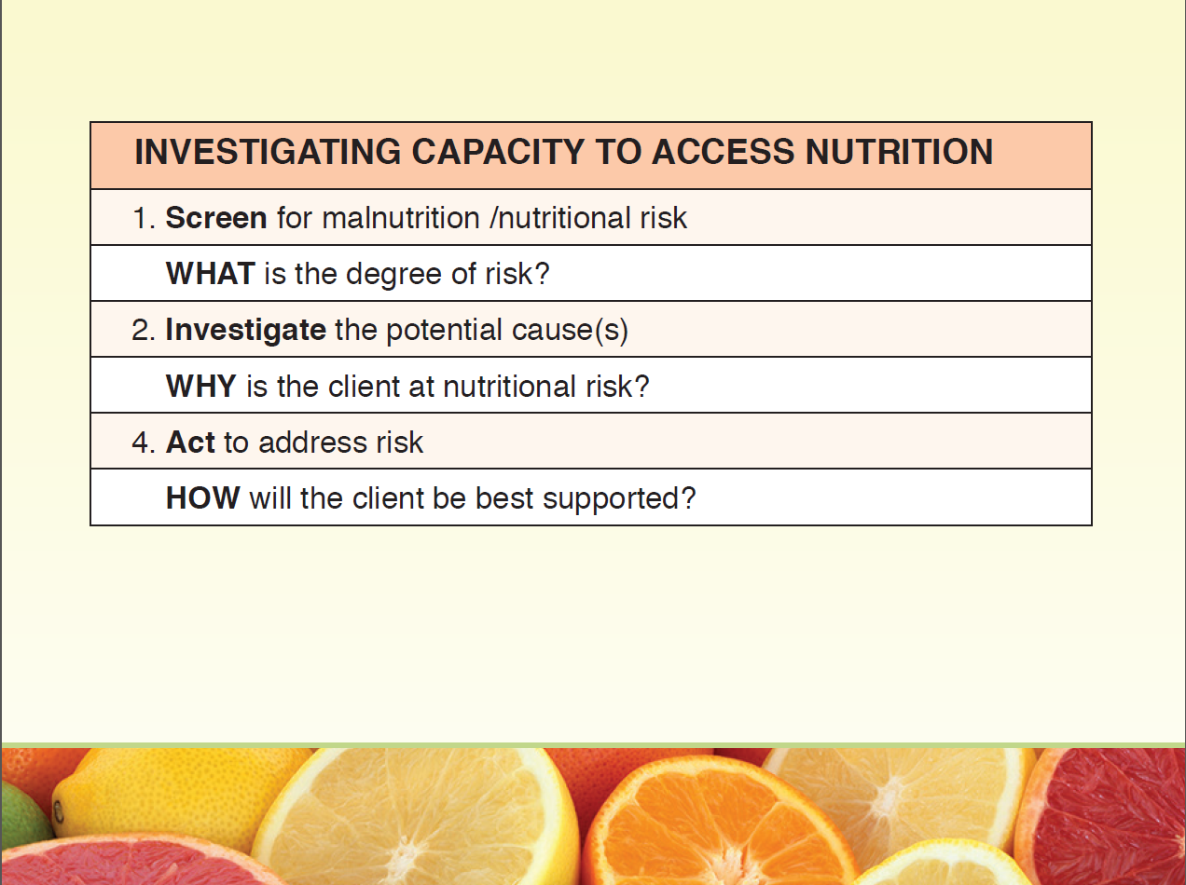

3.
Notes:
Please refer to ICAN template as we talk about each step
We’ve covered how to identify a person at risk in session 2 through the use of the screen tool. This is step 1 of the ICAN tool.
The next step is to investigate why a person may be at risk. This step is crucial for understanding the underlying causes of risk and to ensure the most appropriate support is provided. This ensures that we provide more than a quick fix solution and provide opportunity for restoring capacity.
Step 3 is about the action taken to address risk. Could involve developing a care plan to help restore or maintain support or referring to allied health professionals.

Slide 46
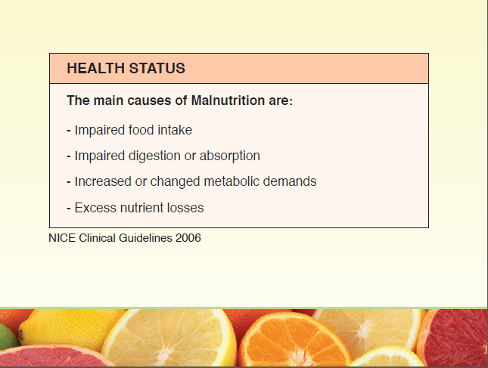
Case Study: Pedro
No weight loss or appetite = 0 Unlikely to be at malnutrition risk
Recently lost partner = 2 | Diet = 1 | Score of 3
Potential for nutritional risk is likely
Notes:
Focus just on Pedro
Pedro had not lost any weight and his appetite and food intake has not decreased. Scored 0 – unlikely to be at risk of malnutrition at the present time
However he had a recent change in circumstances that has had affected what he was eating. His partner had recently died and we could assume the partner did the cooking and shopping since Pedro didn’t know how to cook many dishes and wasn’t confident to do the grocery shopping. Scored 2. As an assessor you were concerned about his ability to have an adequate diet. Scored +1.
Total score 3 – indicating potential for nutrition risk is likely
Pedro at risk in long term if his diet and access to good nutrition doesn’t improve. Opportunity for early intervention to prevent poor health in the future.
Underlying causes could be further explored to direct appropriate action. If Pedro was not ready for action- monitoring would be suitable – rescreen over time and compare scores.

Slide 47
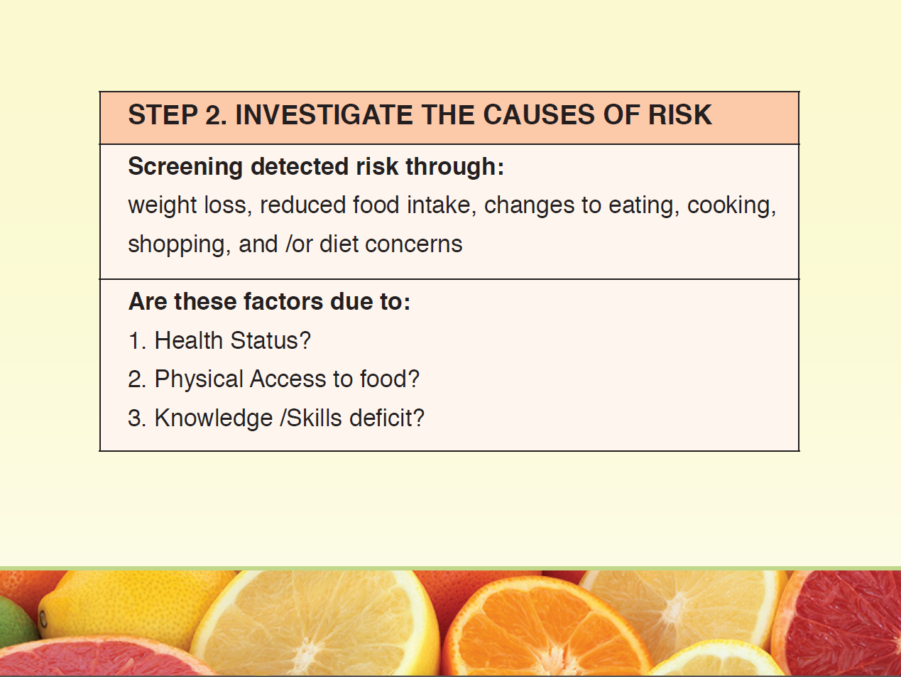
Notes:
If Pedro is happy to continue - looking into what changes Pedro has had to what he eats, how he accesses groceries now and concerns for adequacy in his diet. These are 3 factors to consider.

Slide 48
Notes:
What can cause the above to change?
Eg.
Mental/emotional health decline – pain, depression, grief
Physical health – stomach ulcer, irritable bowel, impaired liver function can affect digestion and absorption
Metabolic changes – respiratory illness, neurological condition, surgery can change nutrition requirements
Nutrient losses – side effect of meds, illness that causes vomiting, diarrhoea, wounds
Once you have identified potential causes, determine whether advice on meeting altered nutrition is required – dietitian to assist with wound healing? Counselling to support grief or mental health? Temporary support of meal services during recovery? Specialist support – pain clinic?
Pedro has recently lost his partner and is probably grieving. He hasn’t lost any weight and his appetite hasn’t changed, this would not be a cause to change his health status.

Slide 49
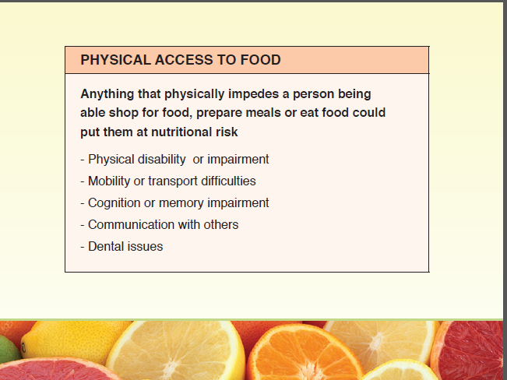
Notes:
Unable to access supermarket to shop for groceries, unable to prepare meals or physically being unable to eat food.
Conditions such as cerebral palsy, weakness on one side, tremors can make it difficult for a person to use kitchen utensils and appliances to put a meal together.
Can they achieve a variety of cooking methods?
Are there any core food groups they don’t each much of due to difficulty in preparation?
Have they seen OT for modified equipment?
Could a dietitian help them simplify their cooking methods
Mobility aids can make it difficult to get around their kitchen or supermarket
Do they have pain when standing to prepare or wash dishes
Can they reach, twist or bend without losing balance?
Dot hey have the strength to carry hot foods from stove to bench in a safe manner?
Are they using public transport to go shopping?
How do they get shopping home?
Do they only buy food they can carry home?
Are they relying on others?
Do they ever run out of food before the next shop
Can the person plan and prepare a shopping list?
Can they follow a recipe?
Are they able to multi-task?
Do they ever forget to eat?
How do they go with communicating their needs when shopping?
Consider also what may be physically making difficult to eat food
How is their dentition?
Do dentures fit?
How is their oral hygiene
Is dry mouth a problem
Are there any foods they avoid because they can’t chew them?
Consider the allied health referrals that could provide support.

Slide 50
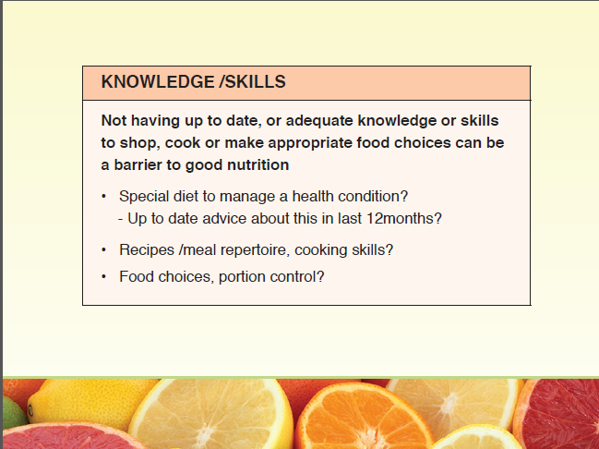
Notes:
Going back to Pedro…
He is less likely to have problems around the physical access issues in the kitchen, however he is more likely to be at nutritional risk because of knowledge and skills deficit around shopping and preparing food, as it sounds like his partner did these tasks for him.
If a person is unfamiliar with cooking and shopping tasks, their food choices may be limited in variety and quality. Also if they have a condition which is managed with a special diet, not having adequate knowledge about diet or up to date information may impact their ability to manage their condition.
Eg. Diabetes, CVD, food allergies, food intolerances, constipation, IBD
In some cases, an annual review with dietitian is advisable to keep the person updated with current research and recommendations.
Other considerations
Do they have recipes or meals they can cook
Do they a good variety foods from 5 food groups
What are the portion sizes like
How confident are they making healthy choices
Do they feel comfortable reading and intepreting food labels
What about food budgeting
Do they ever run out of money for food

Slide 51
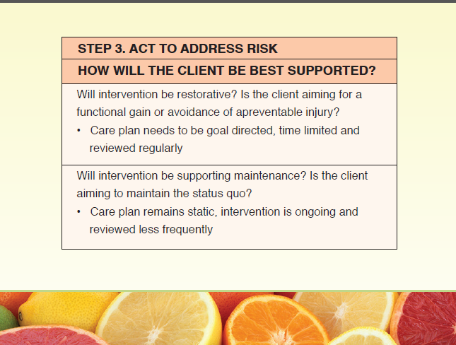
Notes:
It is very common for nutrition issues to be addressed through shopping services and meal provision in an ongoing capacity.
While they support wellness, they may not be addressing the root cause of nutrition risk. They can also have a tendency to be a substitute for a person’s own effort, creating dependency rather than exploring the opportunity for building or restoring capacity to self manage.
The ICAN aims to provide decision support to investigate between the nutrition risk and independent access to nutrition. It is intended to trigger referral(s) for more reabling or restorative, client-centred interventions.
This can involve scaling back support as a person makes functional gains.
Pedro has capacity to make functional gains since he is fairly well and is able to learn and develop shopping and cooking skills. His care plan is likely to be reabling or restorative since the level of support he will require may be scaled back as he achieves his goals.

Slide 52
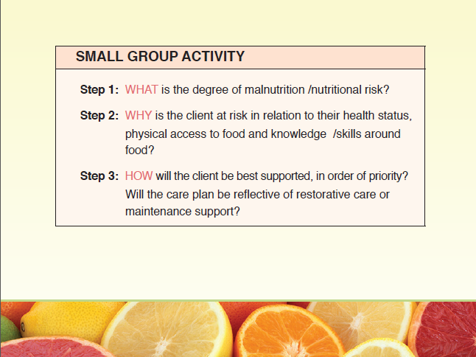
Notes:
Pedro:
Step 1: Potential for Nutritional Risk- likely
Step 2: Pedro has nutritional risk due to lack of knowledge around shopping and meal preparation as wife used to do these things
Step 3: Pedro may be supported by allied health referrals, e.g. to dietitian for cooking/recipe advice or OT for advice around cooking in the kitchen. His would be a restorative care plan

Slide 53
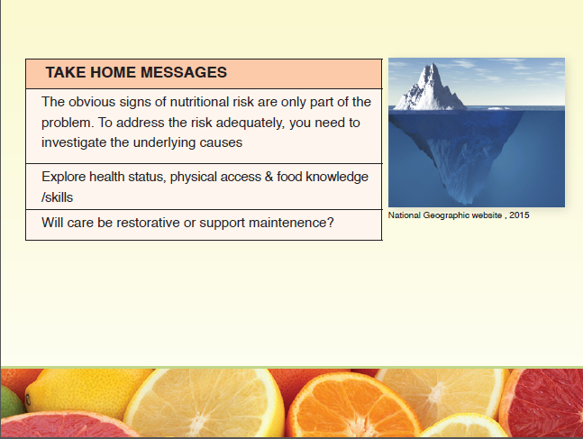
Notes:
Investigating the underlying reasons why a person may be at risk enables the most appropriate strategies to be implemented.
The care plan is fluid where goals are regularly reviewed and support is scaled back as functional gains are made and goals are achieved.
For some where maximum level of functional capacity achieved already. Care plan with strategies that are ongoing are appropriate.
Can you envisage using this tool in your work?

Slide 54
ACKNOWLEDGEMENTS – EATING FOR INDEPENDENCE PROJECT 2016
Project steering committee
HACC Allied Health past and present
HACC Services Benalla Rural City Council & CHPCP
Research mentors
Hume Region Food Services Group
DHHS Hume Region
Training participants

