Slide 1
Referral Pathways for Allied Health and Nursing.

Slide 2
My Aged Care is the national entry point for all Commonwealth-subsidised aged care services.

Slide 3
There is a variety of programs that provide nursing and allied health services for eligible older people in Victoria; including services funded through the Medicare Benefits Schedule and services provided by Community Health, Hospitals and Private Health Services. Handy Hint: Clients do not need to come through My Aged Care to access these health care services

Slide 4
Victorian Regional Assessment Service (RAS) and Commonwealth Home Support Programme (CHSP) service providers transitioned to My Aged Care on 1 August 2016.
From 1 October 2017, clients requiring CHSP allied health and/or nursing services will need to be referred through My Aged Care.

Slide 5
Referrals only need to be made to My Aged Care where the client may be eligible for Commonwealth-subsidised aged care services, such as the Commonwealth Home Support Programme, Home Care Packages, Transitional Care, Short Term Restorative Care, Reablement and also Residential Care.
Handy Hints.
Know your funding source,
Know the difference between CHSP, Home Care Packages, Transitional Care, Short Term Restorative Care, Reablement Care and Residential Care.

Slide 6
Direct to service referrals:
the urgent pathway

Slide 7
A direct to service pathway can be used where a client has an urgent need for a service based on their circumstances which, if not met immediately, may place them at risk.
The services where this is most likely to occur are nursing, personal care, meals and transport.
Handy Hints:
It is acknowledged that there may be a very small number of exceptions to these four service types. If the client’s safety is at risk, you can provide other services in the interim until an assessment is undertaken by a RAS or Aged Care Assessment Service (ACAS) assessor.

Slide 8
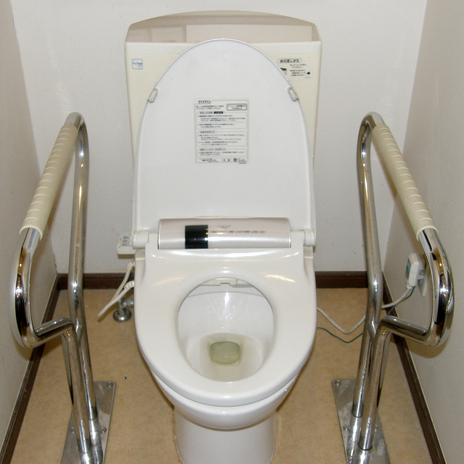
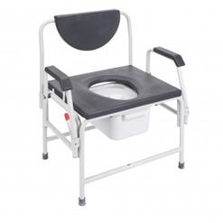

Slide 9
As the service provider, you are expected to make a referral to My Aged Care to arrange for an assessment as soon as possible.
Handy Hint:
I recommend you include information:
Why you have commenced the urgent service,
What date you commenced the service,
Any assessments undertaken should be attached,
This will ensure the assessor is informed and remember you only have 2 weeks to register for assessment.

Slide 10
The RAS and ACAS determine eligibility and make the service referrals for the CHSP service type, i.e. allied health and therapy or community nursing. This covers all the service subtypes, for example, a referral for allied health and therapy includes: podiatry, physiotherapy, occupational therapy, social work, continence etc. If your client has already had an assessment by a RAS, and has a recommendation for allied health and therapy, you do not need to make any additional referrals to My Aged Care in order to provide different allied health subtypes. Call the assessor to add to support plan.

Slide 11
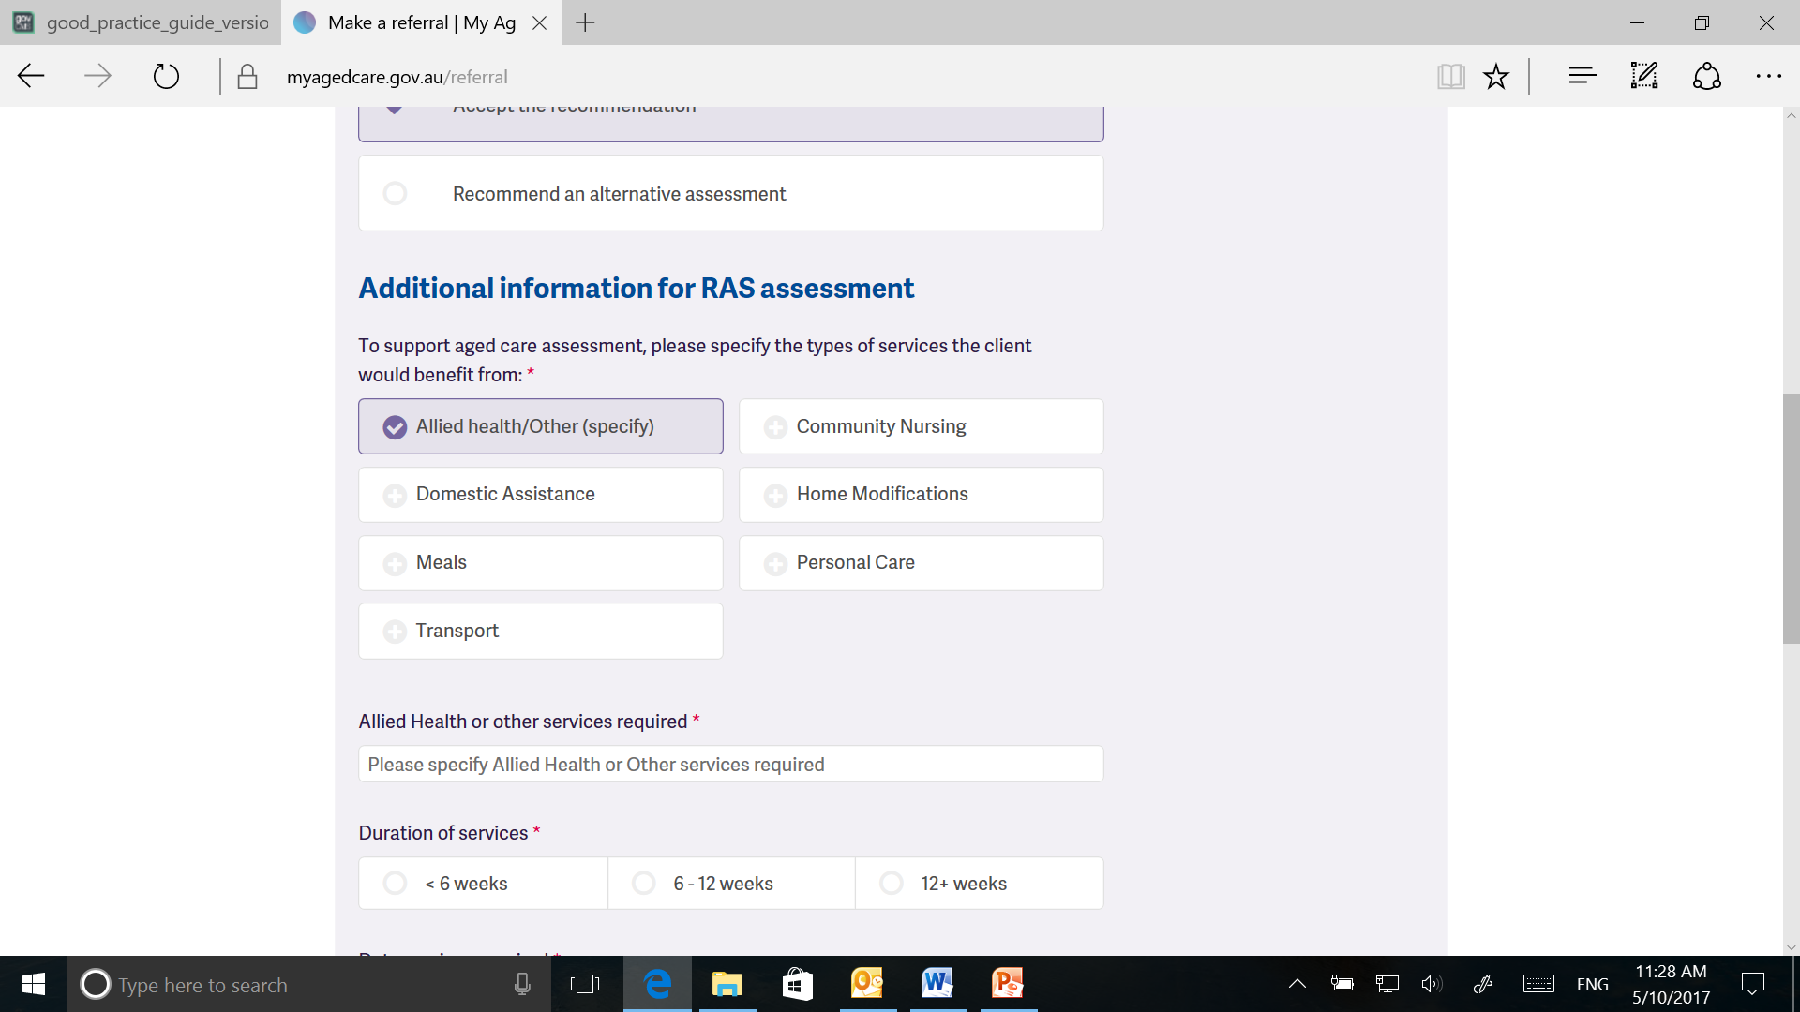

Slide 12
If there are multiple providers required to meet a client’s needs, multiple referrals for allied health and therapy will be required. This is because a referral code can only be used by one provider. This allows the multidisciplinary and co-located allied health professionals to continue the current collaborative practices when providing care to a client. Handy Hint: You should continue to update the client record with any additional service delivery information, this may support additional services.

Slide 13
What to do when a client requires additional services If the clients’ needs or circumstances have changed and you think they may require other services not identified on their support plan, you can request a support plan review. Handy Hints: This can be done from within the service provider portal.

Slide 14
Episodic care
There may be instances where a client who has previously been assessed by a RAS or ACAS and referred to your service, re-presents for additional services.
In this instance, given your service type was recommended on the client’s support plan, you can continue to provide these services.
BUT……..
If you have ‘ceased’ the client from within the service provider portal, you will need to either get the referral re-issued by the RAS or ACAS organisation, or obtain a referral code. A referral code can be obtained by the client from the My Aged Care contact centre.

Slide 15
Robyns@bchc.org.au

